Slide 1
Landscape Water Conservation Challenges
Tim Barr, Director of Water Resources
tbarr@wmwd.com
October 14, 2016

Slide 2
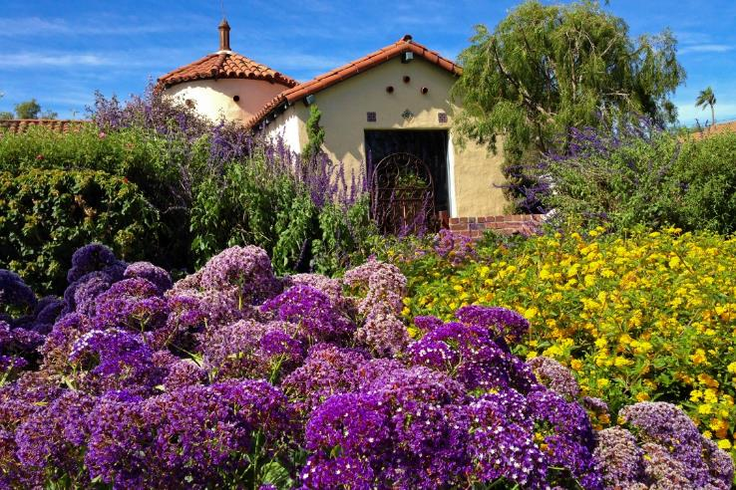
Western Municipal Water District
Topics:
Western’s story – securing our supply
State emergency conservation regulations
Planning for an efficient future

Slide 3
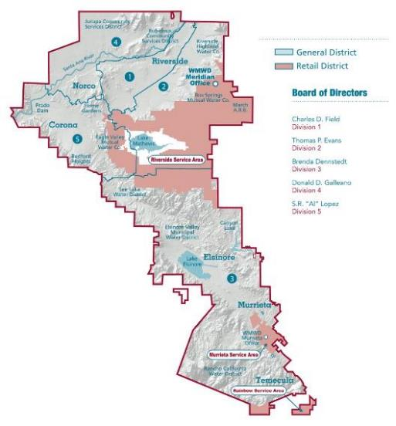
Western Municipal Water District
527 square miles of western Riverside County
Population of nearly 1 million…1.5 million by 2030
25,000 retail customers
13 agencies
Metropolitan Water District member agency
Western has plans for our community’s future that include local supply development and water use efficiency.

Slide 4
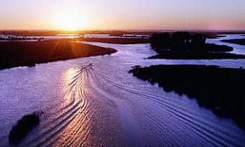
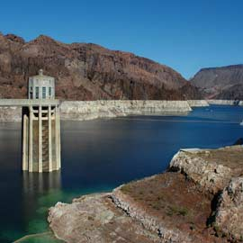
Water Supply Portfolio
Current Sources:
State Water Project
Colorado River
Local Groundwater
Recycled
Future Sources:
Groundwater Desal
Conjunctive Use
Stormwater Capture

Slide 5
Drought Stage 1 – Water Supply Watch
Permanent mandatory prohibitions continually in effect at all stages of water shortage in addition to the specific stage requirements.
Permanent prohibitions include:
Irrigation timers shall be adjusted according to changing weather
Hoses shall be equipped with automatic shut-off nozzles
Landscape watering is permitted only between 8pm and 8am
All plumbing leaks, sprinkler breaks, etc., shall be fixed within 96 hours of notification by Western
No drainage onto adjacent properties or roadways
No wash down of sidewalks, driveways, patios, etc.
Washing of motor vehicles only with bucket or hose with nozzle
Swimming pools and fountains must re-circulate water

Slide 6
Stage 3 – Targeted Waste Reduction
Objective is to reduce water system consumption within the retail service areas by up to 15%.
Three sub-stages (A – C)
Eliminate all adjustments to existing outdoor water budgets No expansions of landscape area No swimming pool refill credits
Eliminate Billing Tier 4 Water use above 125% of water budget charged Tier 5 rate
Current stage
Eliminate Billing Tier 3 Water use above 100% of water budget charged Tier 5 rate

Slide 7
Stage 4 – Targeted Outdoor Reduction
Objective is to reduce water system consumption within the retail service areas by 16% to 50%.
Three sub-stages (A – C)
Reduce all landscape/outdoor water budgets by up to 10% Request voluntary reduction in commercial water use
Reduce all landscape/outdoor water budgets by up to 40% Reduce all commercial water budgets by up to 15% No new meters (construction or service)
Highest stage Western has ever been in (2015)
Reduce all landscape/outdoor water budgets by up to 65% Reduce all commercial water budgets by up to 30%

Slide 8
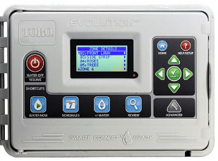
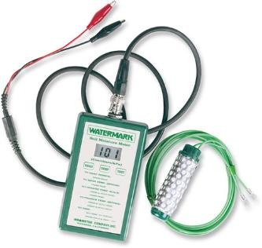
Customer Support Programs
Metropolitan Water District offers customers rebates on water saving devices. Western adds funding to select devices.
Smart Irrigation Controllers
Soil moisture sensing
Weather-based
High efficiency clothes washers
High efficiency toilets
A full list of devices and incentives is available at
www.socalwatersmart.com
Notes:
John

Slide 9
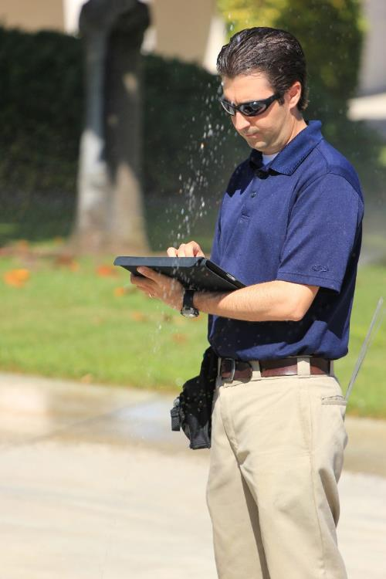
Customer Support Programs
Western offers free landscape efficiency evaluations to commercial and residential customers.
Includes customized recommendations to improve efficiency in the landscape and indoors.
Prioritizes repairs and provides photos of problem areas.
Measures irrigated area by meter; useful for water budget accuracy.
Notes:
John

Slide 10
Budget-based Water Rate Structure
UNSUSTAINABLE WATER USE
Tier 5
Residential Water Budget
WASTEFUL
WATER USE
Tier 4
INEFFICIENT
WATER USE
Tier 3
OUTDOOR
WATER USE
Tier 2
INDOOR
WATER USE
Tier 1
The rate structure is based on the cost of service and efficient water use.
The rate structure rewards water efficiency
and penalizes water waste.

Slide 11
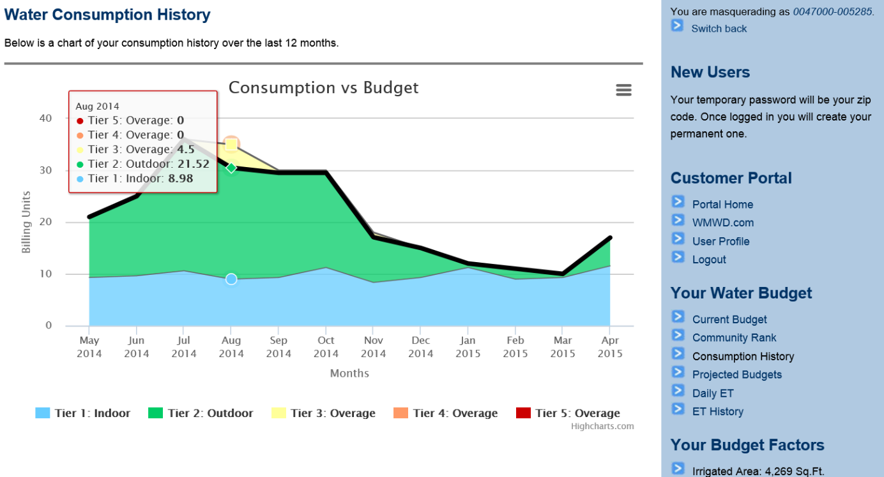
How to Stay Within Your Water Budget
Visit: YourWaterBudget.wmwd.com
Notes:
Tim

Slide 12
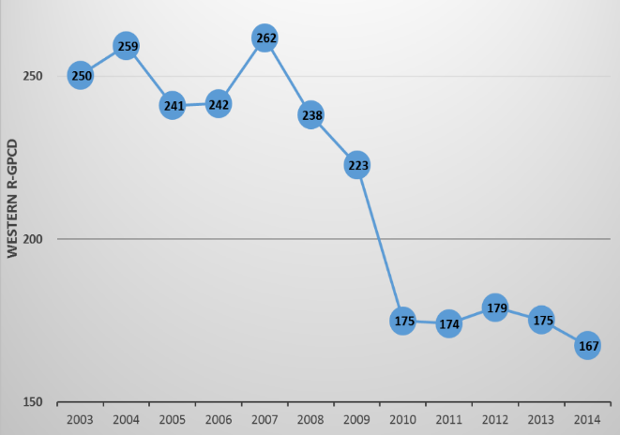
Customers Embracing Efficiency
Annual Residential Per Capita Use
5-YEAR AVERAGE = 248
2008 – Board Adoption of Water Efficiency Master Plan resulted in downward
changes in demand
30% Reduction
5-YEAR AVERAGE = 174

Slide 13
How did we get here?
Notes:
John

Slide 14
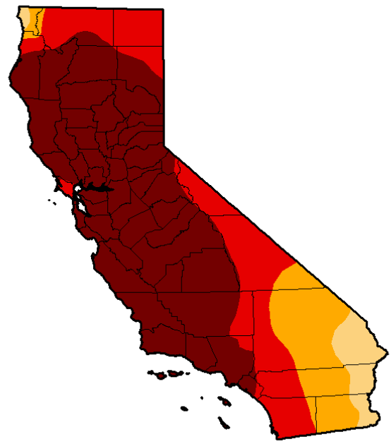
Unprecedented Conditions
Water Year (WY) 2012-2013
Below average runoff
Calendar Year 2013
Driest on record
January 2014
Lowest snowpack
WY 2014
4th lowest runoff
2014 State Water Project Allocation
5% - lowest ever
2014 Temps
Record high temperatures
82%
Extreme and
Exceptional

Slide 15
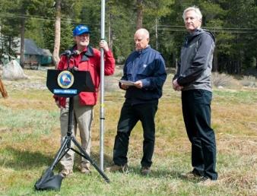
2015 Emergency Regulations
Governor’s Executive Order on 4-1-15
25% reduction ordered
4% to 36% reduction from 2013 base period
Western 32%
Eastern & RPU 28%
Suppliers assigned targets based on 3-months of 2014 summer water use
Issue information and conservation orders for non-compliance

Slide 16
Projected Reduction from Shortage Stages
Shortage Stage | Murrieta | Riverside
3(a) | - | -
3(b) | 6–8% | 6–9%
3(c) | 10–13% | 10–15%
4(a) | 12–15% | 12–17%
4(b) | 21–24% | 22–27%
4(c) | 41–44% | 34–39%
Projections based on reduction measures listed as probable scenarios in Ordinance 384
Notes:
Slide 10
The WSSCP stages and sub-stages, when implemented, will result in reductions from 2013 water use. The ranges presented are based on actual water use data in each customer sector and the implementation of a shortage stage as written in Ordinance 384. Each sub-stage of the Ordinance lists the maximum reductions. The ranges were developed using projected behavioral responses of customers to both the shortage declaration and also making contact with customers to drive demand down. The behavioral responses were estimated using three years of customer reaction to water budget rates and customer support programs. The ranges include only Murrieta and Riverside service areas and do not include the March East or Rainbow service areas.

Slide 17
Board Action
Adopt Resolution 2910 implementing:
Shortage Stage 4, Sub-stage (b) (modified)
Reduces all landscape budgets 30%
Reduces commercial budgets 10%
Tier 5 pricing for over-budget use
Additional provisions (Exhibit B)
Items in Governor’s Executive Order
Provisions in State Board Regulations
Construction water, flushing, fire flow testing
Notes:
Staff is recommending that the Board adopt Resolution 2910 which implements Shortage Stage 4 (b) with provisions for a 30% reduction in outdoor water budgets and 10% reductions in commercial water budgets. This action will also result in any customer that exceeds their water budget paying the applicable Tier 5 water rate. As allowed by the California Water Code and listed in Western’s adopted WSSCP, penalties collected during Stage 4 (b) can be used to:
Enhanced conservation programs;
Outreach programs
Enforcement of prohibitions and restrictions;
General operations and maintenance expenses, including those incurred as a result of reduced water sales; and,
The difference between budgeted revenue expected from operations and maintenance component in the water rates and actual revenue received; and
Payment of penalty expenses incurred.

Slide 18
Reducing outdoor water budgets
(a simplified view after the mandated 32% reduction)
100% Indoor Allocation
70% Outdoor Allocation

Slide 19
Western’s adjusted allocation rate tiers
100%+ of Adjusted Budget
ADJUSTED BUDGET
100% of indoor + 70% of outdoor
Water Pricing
$
Tier 1
Indoor
Tier 2
Outdoor
Tier 5 Unsustainable
Customer Water Use

Slide 20
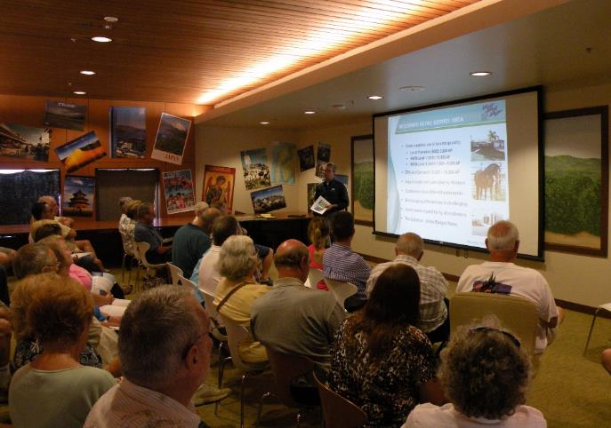
2015 Emergency Regulation
Actions taken by suppliers:
Implemented shortage plans
Held information sessions
Increased program incentives
Increased public outreach
Reported to State Board monthly

Slide 21
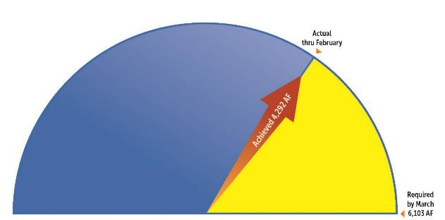
Cumulative Progress Report
Actual
Conservation Achieved
Additional Conservation
Needed to meet mandate
Cumulative reduction through Feb 2016 was 23% percent
Is Western a bad actor by missing the 32 percent target?
Considering reductions prior to the 2015 mandate,
Western’s customers reduced by more than 50%.
The methodology is flawed, something must change.

Slide 22
How much is enough?
Annual Residential Per Capita Use
5-YEAR AVERAGE = 248
2008 – Board Adoption of Water Efficiency Master Plan resulted in downward
changes in demand
30% Reduction
5-YEAR AVERAGE = 174
Western’s customers reduced before the 2015 mandate. Applying a 32% Conservation Target to the 2013 Base Period resulted in a 62% community impact!

Slide 23
2015 Emergency Regulation
Source: April 4, 2016 Staff Presentation to the State Board
Quite an accomplishment by California's urban water users

Slide 24
A bit of relief…
Notes:
John

Slide 25
2016 Extension of Regulation – April/May
Conditions have changed:
On April 1, 2016:
Cumulative Northern Sierra Precipitation at 124% of average
Northern Sierra Snowpack at 94% of average
Flood control releases occurring at key reservoirs
“It doesn’t feel like an emergency anymore.”

Slide 26
A fox in the hen house?
What is Water Supplier “Self-certification”
What is Water Supplier “Self-certification”
The calculated gap between supply and demand in 2019 is the water supplier’s new Conservation Standard
Assume annual water demand is the average of 2013 and 2014.
Assume the next three years (2017, 2018, 2019) have the same hydrology as 2013, 2014, 2015.
The new Conservation Standard is the percentage by which the suppliers’ total water supply is insufficient to meet the total potable water demand in 2019.
Notes:
Tim

Slide 27
Monthly Progress Report
Preliminary
June 2015−September 2016 Cumulative Reduction: 21%
June 2016−September 2016 Cumulative Reduction: 15%
-15%
-10%
-19%
-17%
-30%
-33%

Slide 28
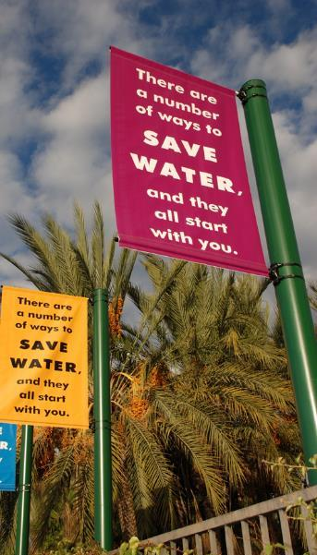
Long-term Water Efficiency in California
California Urban Water Policy should:
Achieve high levels of local efficiency by:
Encouraging investments in local water supply development and demand management programs
Establishing a reasonably defined bar for residential and landscape water use
Incentivizing California’s end users to replace non-water conserving fixtures, appliances, and landscapes

Slide 29
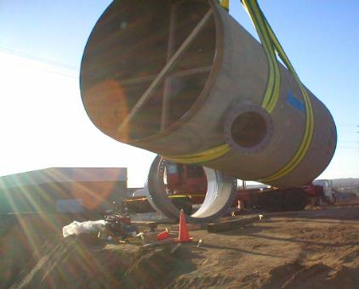
Long-term Water Efficiency in California
California Urban Water Efficiency Policy should:
Incorporate considerations for:
diversity in supply availability
supply portfolios
regional climate
population trends
housing density
past conservation activities
Require common-sense prohibitions on:
end-user water waste activities such as irrigation over-spray and run off into curbs and gutters
Utilize water use standards developed by subject matter experts.

Slide 30
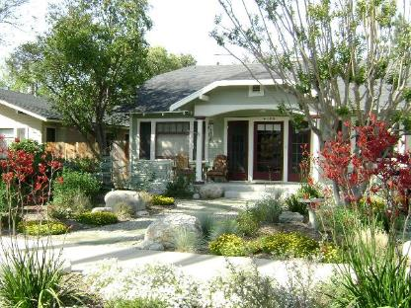
Long-term Water Efficiency in California
California Urban Water Efficiency Policy should not:
Apply mandates without considering water supply availability at the local level
Assume that high water use is the same as inefficient water use
Apply different standards to a population based on geographic location
Disadvantage one region of the State over another
Mandate a specific or global approach to water pricing

Slide 31
Executive Order B-37-16
State Agency Objective: Develop a Report to the Governor’s Office with recommendations designed to… Make Conservation a Way of Life in California
Timeline: Public Draft – November 4, 2016 Public Comments – November 14, 2016 Final Report – January 10, 2017 (mandated date)
Roles: Urban Advisory Group (UAG) – John Rossi, General Manager Technical Work Groups – Tim Barr

Slide 32
Executive Order B-37-16
Major components:
Eliminate Water Waste
Strengthen Local Drought Resilience
Use Water More Wisely
Improve Agricultural Water Use Efficiency and Drought Planning

Slide 33
Eliminate Water Waste
Permanent Prohibitions and Restrictions:
Hosing off sidewalks, driveways and other hardscapes;
Washing automobiles with hoses not equipped with a shut-off nozzle;
Using non-recirculated water in a fountain or other decorative water feature;
Watering landscapes in a manner that causes runoff, or within 48 hours after measurable precipitation; and
Irrigating ornamental turf on public street medians.

Slide 34
Strengthen Local Drought Resilience
Develop Shortage Contingency Plans that defines:
The “annual assessment” process and timeline
Triggering criteria that would initiate responses
Response actions to mitigate shortage
A communications plan with budgets, messages and methods that vary with responses
Addresses financial elements
Customer compliance and enforcement

Slide 35
Use Water More Wisely
The Department of Water Resources (DWR) shall work with the State Water Resources Control Board (Water Board) to develop new water use targets as part of a permanent framework for urban water agencies based on strengthened standards for:
Indoor residential per capita water use;
Outdoor irrigation, in a manner that incorporates landscape area, local climate, and new satellite imagery data;
Water lost through leaks; and,
Commercial, industrial, and institutional water use.
The first three individual targets would be rolled up into one annual compliance metric.

Slide 36
Use Water More Wisely
Proposed Indoor Residential Standards:
SBx7-7 set existing standard as 55 GPCD
Proposed standard:
55 GPCD
Revise downward based on additional studies
State will reevaluate in 2025 for 2030 standard

Slide 37
Use Water More Wisely
Proposed Landscape Standards:
Standard will start with existing SBx7-7 outdoor standard using the MWELO ETAF that was in place when the property was developed:
Pre 2010 0.8
2010 to 2015 0.7
2016 to present 0.55 residential
0.45 commercial
Special Landscape 1.0
*MWELO = Model Water Efficient Landscape Ordinance
*ETAF = Evapotranspiration Adjustment Factor

Slide 38
Use Water More Wisely
Water Loss Standards:
Building on recently passed SB 555
DWR currently developing rules for validations of water loss audits
Annual water loss audit data submission to DWR beginning October 2017
Water Board rulemaking to set water loss standards to commence in 2019

Slide 39
Reporting/Compliance Timeline
2017 Report to Governor’s Office
2018 Technical Guidance Document DWR to provide land use map to suppliers Finalize indoor/outdoor standards for 2025
2019 Report provisional target and water production (with narrative of compliance and planned actions)
2020-5 Progress reports
2021 Urban Water Management Plan for 2020
2022-5 Reassess standards for 2030
2026 Compliance report and enforcement, if necessary

Slide 40
Thank you!

