Slide 1
Urban Forest Management Plan Grant Program
April 24 & April 25, 2012
Inland Urban Forest Council
Riverside, CA
Webinar Two
Funded by: US Forest Service &
Cal Fire

Slide 2
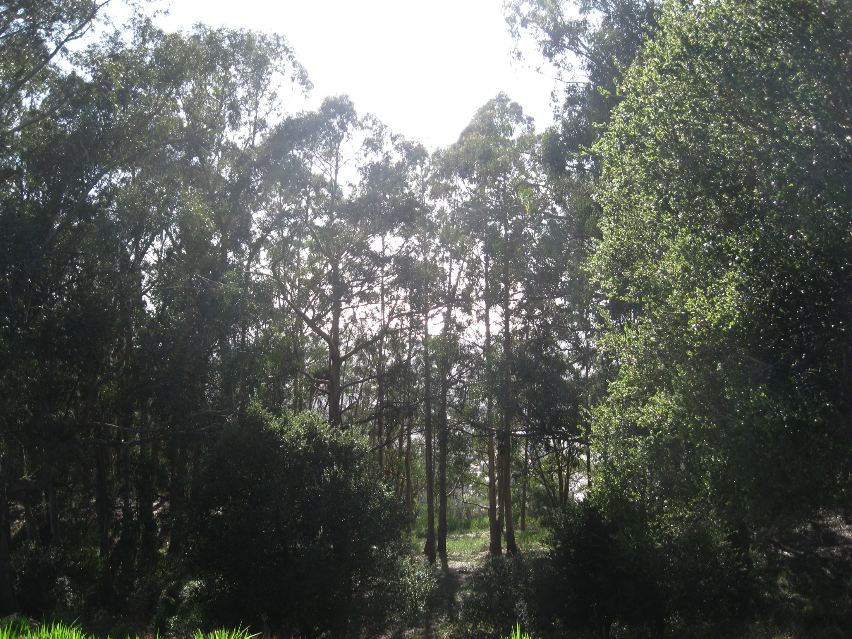
Welcome!!!

Slide 3
Today’s Agenda
9:30 – 9:35 Welcome
9:35– 10:25 Vision, Mission, Goals & Objectives
10:25 – 10:30 What is Next

Slide 4
What Do You Want?

Slide 5
Introduction

Slide 6
Vision and Mission
Often confused, vision is what the organization wants to show the public. It is a written statement describing the big picture. Mission is more a statement of purpose.

Slide 7
Vision
Work without Vision is Dreadful and Vision without Work is Self-Deception

Slide 8
Vision Statement
Vision Statement is the big picture--what you or the organization want the Urban Forest to be.

Slide 9
Creating that Vision Statement
Diversity of Age and Species
Canopy Cover
BMPs
Maximum Benefits

Slide 10
Example Statement
Riverside’s Urban Forest is a well maintained, diverse population of trees that covers 30% of the community and provides maximum benefit to its citizens.

Slide 11
Seattle’s
Seattle's urban forest is a thriving and sustainable mix of tree species and ages that creates a contiguous and healthy ecosystem that is valued and cared for by the City and all of its citizens as an essential environmental, economic, and community asset.

Slide 12
Defined by the Foursight Consulting Group
A vision is a statement about what your organization wants to become. All members of the organization should be able to identify with it and it should help them feel proud, excited, and part of something much bigger than themselves. A vision should stretch the organization’s capabilities and image of itself. It gives shape and direction to the organization’s future.
Visions range in length from a couple of words to several pages; the shorter it is, the easier it is to remember. Effective vision statements are clear, concise, catchy and memorable.

Slide 13
Their Example
From President Kennedy:
“Land a man on the moon and safely return him to earth by the end of this decade”

Slide 14
Broader Vision Statement
Vision
Sustainable Riverside maximizes energy efficiency and makes the most efficient use of resources, and minimizes negative environmental consequences. Above all, it means meeting the needs of its citizens while not degrading or destroying the natural and constructed systems that will sustain future generations.

Slide 15
Revised Vision Statement
Riverside’s Urban Forest is a well maintained, diverse population of trees that covers 30% of the community and provides maximum benefit to its citizens.
Riverside’s Urban Forest makes the most efficient use of resources to provide a diverse population of trees that covers 30% of the community and provides maximum benefit to meet the needs of its citizens.

Slide 16
Challenge
You may want to challenge yourself or your organization.

Slide 17
Mission Statement
How is this vision going to be implemented.

Slide 18
An Effective Mission Statement
An effective mission statement looks at 1. what you do , 2. how you do it, 3. why you do it and 4. for whom you do it.
Again, clear and concise.

Slide 19
Sample Statements
Dedicated to improving the urban forest by: Working with citizens, businesses, government agencies and tree care professionals in maintaining and renewing a safe, healthy, and diverse mature tree canopy to enhance the beauty and prosperity of the community.

Slide 20
Samples
Sacramento’s: To Promote a Safe, Sustainable, and Healthy Urban Forest for Sacramento Communities.
US Forest Service: “Sustain the trees and forests where people live, work and play.”

Slide 21
Others
The mission of the Urban Forestry Division is to promote healthy urban forests through leadership, education, awareness, and advocacy so as to enhance the beauty and prosperity of the community.
Friends of the Urban Forest's mission is to promote a larger, healthier urban forest as part of San Francisco’s green infrastructure through community planting, tree care, education, and advocacy.

Slide 22
Last One
The Mission of the Urban Forestry Division is the management of Round Rock's urban forest through the use of the best management practices and the communication of such to citizens, employees, and developers of Round Rock, with a focus on education, tree planting, tree preservation, tree care, and enforcement.

Slide 23
Goals and Objectives

Slide 24
Definitions
Goals ‘“ are long-term aims that you want to accomplish.
Objectives ‘“ are concrete attainments that can be achieved by following a certain number of steps.

Slide 25
Hints
Goals have the word “Go” in it.
Objectives have the word “Object” in it.

Slide 26
Summary
Goals and objectives are both tools for accomplishing what you want to achieve.
Goals are long term and objectives are usually accomplished in the short or medium term.

Slide 27
From the Toolkit
The goals in your plan are the general outcomes that you seek to achieve. Goals may address some or all of the needs you have identified. They can also address other concerns or desires of the stakeholders.
If funding is limited, goals should be prioritized so that resources can be directed toward the most important goals first.

Slide 28
Also from the Toolkit
For municipal plans, goal setting may involve input from staff, consultants, elected officials, and community residents. General consensus on the management plan's goals can help ensure that necessary resources will be made available to implement the plan.

Slide 29
Needs Categories
The Tree Resource,
Management,
Community Interactions.

Slide 30
Goals – Tangible and Quantifiable
If you are explicit in stating your goals (e.g., attain 35 % canopy cover by the year 2020), it will be easier to evaluate your progress toward your goals. If you state goals more generally (e.g., improve level of tree care on commercial properties), you may want to set specific benchmarks to indicate how success will be measured

Slide 31
Summary: Management Goals of the Community Forest Management Plan
Goal 1. Improve the quality of the Community Forest (consisting of all public and private trees) over time in ways that will optimize environmental, economic, habitat, food and social benefits to the City and its neighborhoods.
Goal 2. Promote planting, preservation and protection of the existing Community Forest resource.
Goal 3. Continue to maintain the City's trees in a safe and healthy condition as cost effectively as possible.

Slide 32
Continued
Goal 4. Facilitate collaboration among City departments related to issues and projects involving trees.
Goal 5. Provide awareness of the importance of the Community Forest; educate the community on proper tree planting and care; and encourage greater participation in tree planting and stewardship activities.
Goal 6. Adopt the Community Forest Management Plan to guide long–term tree planting and maintenance activities, and update it every five years.

Slide 33
Objectives
Objectives provide more specificity by breaking goals into the components that make up each goal. Like goals, objectives are desired outcomes, but are more specific and limited in scope.

Slide 34
Example from Toolkit
Goal to increase canopy cover from 20% to 25% within 10 years.
This goal is explicit and quantifiable, but doesn't indicate what needs to be done.

Slide 35
What needs to be Done?
Maintain most or all of your existing canopy cover through proper tree maintenance and protection of existing trees
Plant additional trees and/or allow existing small trees to grow and expand their canopy cover

Slide 36
Objectives can serve more than one Goal
Tree planting can contribute to both canopy cover and increased age diversity in the urban forest.
You may want to cite a given objective under multiple goals to show such relationships.

Slide 37
Examples of Goals and Objectives
Goal 3. Choose and locate new trees to maximize tree-related benefits.
Objective 3.1. Match species to sites to the greatest degree possible.
Objective 3.2. Increase the use of large-canopy trees where practical to maximize tree benefits relative to costs.
Objective 3.3. Locate new tree plantings in areas that will maximize energy conservation in buildings and shading of pavement.

Slide 38
Example 2
[Goal] 3. Preserve and Protect Native, Significant, and Historical Treescapes.
Promote protection guidelines for conservation of historical treescapes through the City of Walla Walla's Heritage Tree Ordinance. (Municipal Code 12.50)
Plant potential trees or groves to attain significant historical and aesthetic value.
Promote memorial and honorary tree groves.

Slide 39
Goal 4. Facilitate collaboration among City departments related to issues and projects involving trees.
Policy 4.1 Review existing Tree Division staffing levels. Create City Arborist (and/or professional Urban Forester) job description and continue to maintain the position with a highly qualified urban forester.
Policy 4.2 Follow existing plan review process that includes the City Arborist's review of public works projects and/or projects requiring a building permit or discretionary project review and their potential impacts to the Community Forest, according to provisions of the Tree Planting, Preservation and Protection Ordinance.
Policy 4.3 Establish an annual tree management plan, prepared by the City Arborist.
Policy 4.4 Implement a landscape inspection and ordinance enforcement process to promote compliance with City policies and regulations that influence the Community Forest.

Slide 40
Goal-create a citizen advisory board for urban forestry issues.
A. Develop a Forest Board that is made up of tree specialists and citizens representative of the scope of urban forestry issues in our city.
B. Develop a set of operation criteria for the Forestry Board that has it develop and consider urban forest plan amendments, work on special urban forestry projects and advise the council of urban forest issues.

Slide 41
In Summary
The combination of goals and objectives spell out what you want for your urban forest. They describe your desired destinations. How you get to those destinations, by using specific actions and tools.

Slide 42
Review
Vision is that future picture.
Mission is implementation of vision, what you do, how you do it, why you do it and for whom you do it.
Goals are your long term aims as to what you want to accomplish.
Objectives are the steps to achieving the goals.

Slide 43
What is Next & Assignments

