Slide 1
Urban Forest Management Plan Grant Program
August 21 & 22, 2012
Inland Urban Forest Council
Riverside, CA
Webinar Five
Funded by: US Forest Service &
Cal Fire

Slide 2
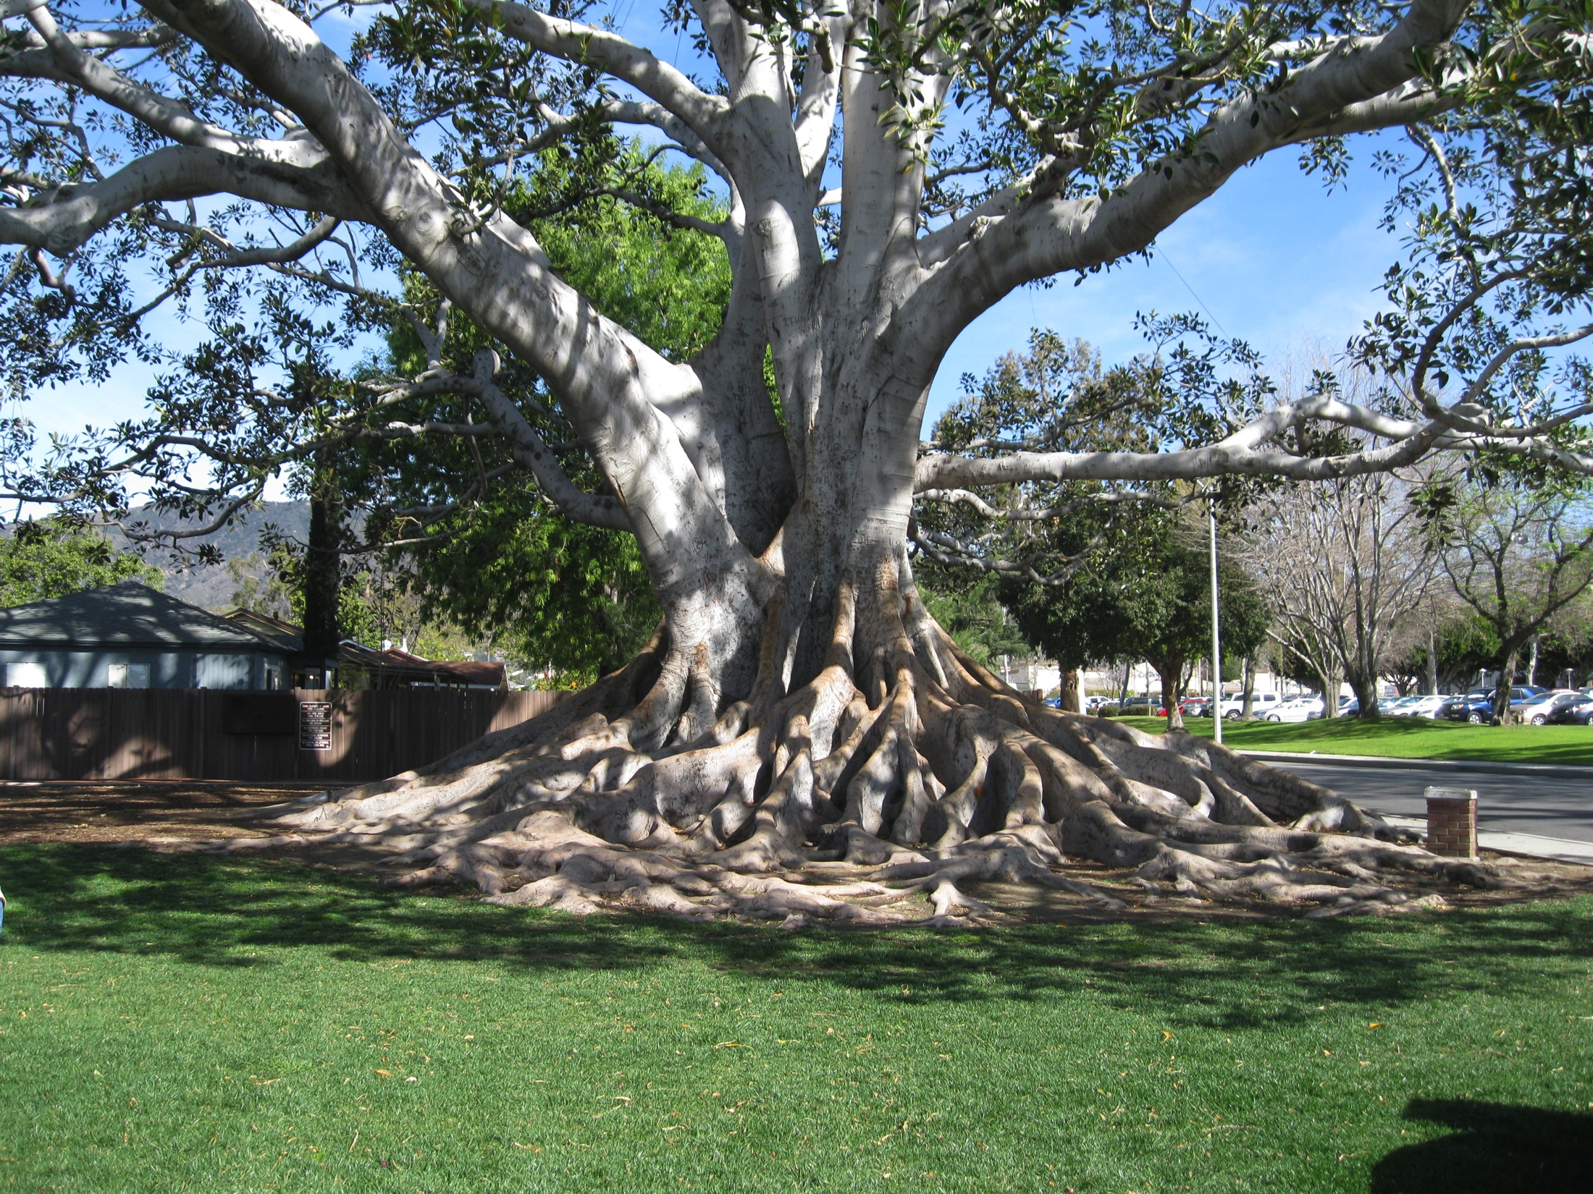
Welcome!!!

Slide 3
Today’s Agenda
9:00 – 9:05 Welcome
9:05– 10:00 The Last Steps
Monitoring Plan
Implementation Plan
Putting it all together
10:00 – 10:25 Issues – Group Discussion
10:25 – 10:30 Next Step

Slide 4
Steps for Developing an Urban Forest Management Plan
Step One: Why do you need a plan?
Step Two: Assess what you have.
Step Three: What are your needs?
1. Tree Resource Needs
2. Management Needs
3. Community Needs
Step Four: Develop your action plan.
1. Goals
2. Objectives
3. Actions
Notes:
We take the basic principles of management and put them into the following nine steps.

Slide 5
Steps for Developing an Urban Forest Management Plan
Step Five: Implementation Plan
Step Six: Budget and Funding
Step Seven: Complete Documents
Step Eight: Adoption
Step Nine: Are you getting what you want? Monitoring plan

Slide 6
Goal of Monitoring Plan
The goal of the monitoring plan is to provide the data/information that is needed to understand what is happening, why it is happening, and how specific management adjustments will change the outcome.

Slide 7
Monitoring Program/Plan
Why?
What?
When?
Where?
Who?
How?

Slide 8
Why Monitor?
Form of Measurement
Re-evaluate the plan
Gathers history
Why did something work or not work
Refine Management

Slide 9
What/where are you going to monitor?
Goals, Objectives & Actions should already have a measurable component.
May wish to monitor a representative sample rather than the entire area covered by the plan.
Are there time or financial considerations?
Does everything need a monitoring plan?
Set priorities based on importance of the goal in the plan.

Slide 10
When?
Will data be collected continuously (e.g., inventory updated by work records) or at specific intervals?
Does some data need to be collected in a specific season or time of year?
Canopy cover in summer.
Disease and insect problems in their season.
How frequently will you do data summary and analysis?
Tree growth may be slow.
Tied to budget or mid year reports.
Storm Damage occurs fast need to be prepared.
New Pest or Disease outbreaks can be slow or fast.

Slide 11
How?
How will you gather and analyze the monitoring data?
Are you already collecting the data you need (e.g., in your tree inventory)?
Will you need to initiate additional sampling or record keeping?
How and where will you store the data?

Slide 12
Who?
Who is going to gather the information?
Who is going to analyze it?
Who is going to do the reporting?

Slide 13
1st Planning Question from Toolkit
What do we need to monitor to determine if the plan is having its desired effects?
Go back to your Data Analysis and Goals.
What were the issues?
What were the priorities?
Is the plan successfully addressing these goals?

Slide 14
2nd Planning Question from Toolkit
What questions do we need to answer to improve our urban Forest management?
Tree preservation
Is tree health improving?
Is there better communication among departments, board members, etc.?
Do others understand and embrace the value of the urban forest to community?

Slide 15
3rd Planning Question from Toolkit
How can we ensure that monitoring data is used to improve and update our management techniques?
Get the info to all the right people!!!
Staff above and below.
Management
Elected Officials
Board Members
Chancellors
Stakeholders
Public

Slide 16
Monitoring Program/Plan
Questions
Comments

Slide 17
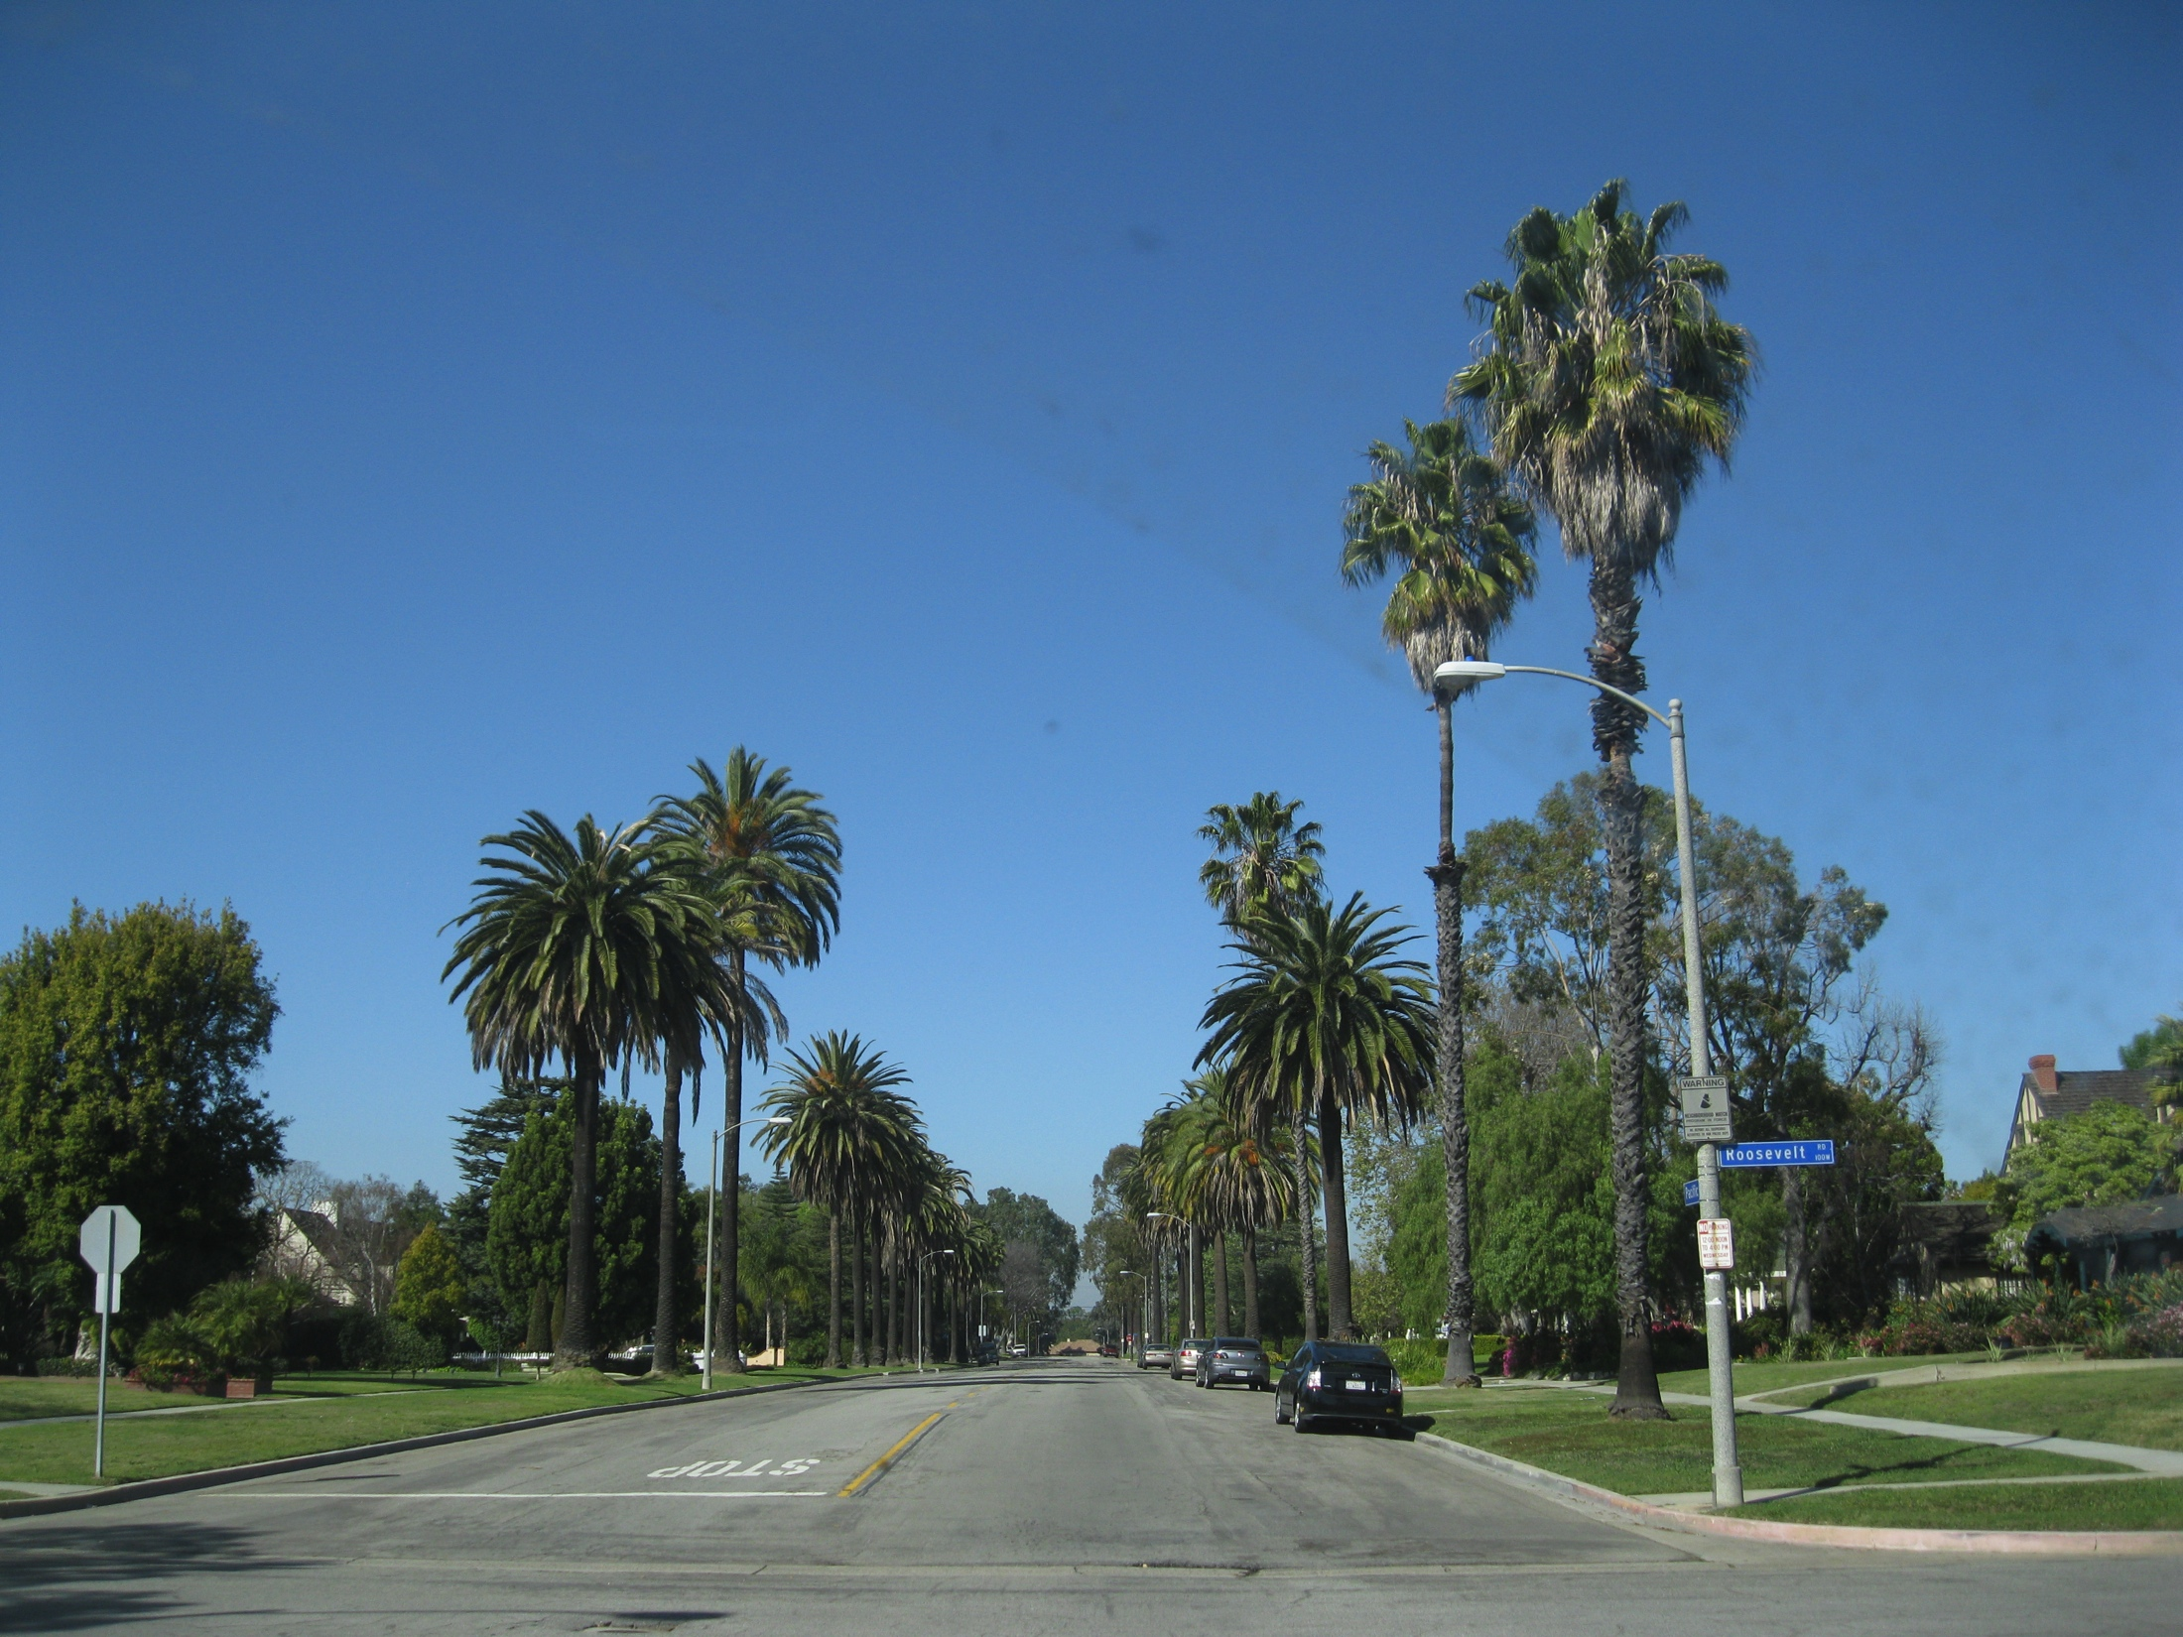
Implementation Plan
The management plan sets goals
and objectives, which provide
the overall destinations of the plan.

Slide 18
Implementation Plan
It lists actions needed to accomplish the goals and objectives.
The implementation plan is where you describe how these actions will be carried out.

Slide 19
Implementation Plan
For each action, the implementation plan spells out:
Overall Priority Ranking
Funding Source(s)
Specific Budget
Responsible personnel for carrying out the action
Time schedule

Slide 20
Time Frame
Implementation of a long term management plan occurs in phases: Short, Medium & Long
Implementation plans usually span short time slices (1-5 years).
They should be revised as necessary based on factors that speed or slow plan implementation.
Developing, revising, and adopting implementation plans typically occurs at program staff level (those of you here)

Slide 21
Implementation Plan Cont.
As the implementation plan is developed, it may become clear that some actions actually require multiple steps to complete. If so, it may be useful to specify the budget, responsibilities, and time schedule, for each separate step.

Slide 22
Setting Priorities
The management plan should include a general priority ranking of goals, objectives, and their associated actions.
As you develop the implementation plan, you may need to review and adjust priorities for the shorter planning intervals involved.
Overall priority rankings will be needed to determine how to allocate budget if it is inadequate to cover all activities.

Slide 23
Setting Priorities
Priority rankings are also used to phase activities over time so that high priority tasks are completed before low priority tasks. For example, dealing with a backlog of potentially hazardous trees may be the highest priority in the first years of the plan. Once the backlog has been cleared out, other actions (such as replanting after tree removals) may have the highest priority.

Slide 24
Identify Funding
You know your current funding sources.
In this process may have identified new sources.
One of your goals may be to identify additional sources of funding.
You also may have a goal of implementing the new sources that you have already identified.
On going activities such as tree care need stable sources of funding.
Other programs such as planting may use grant opportunities.

Slide 25
Developing Budgets
For ongoing activities, work records and past budgets provide a basis for making budget projections.
For other activities, you may need to get estimates from others?
You may also need to estimate staff time, apply appropriate budget costs based on these estimates and then revise as time and experience provide more accurate numbers.

Slide 26
Budgeting
For contracted work, administrative costs for bidding and managing the contract should be included in the budget.

Slide 27
Budgeting Cont.
Costs associated with in-house work will include personnel costs and materials, as well as overhead costs related to equipment maintenance and training.

Slide 28
Budgets
Budgets typically need to account for inflation, equipment replacement, and other factors that change from year to year.
Budgets also need to account for how costs change as the tree population changes over time. As trees get larger or develop age-related problems, unit costs may increase.
On the other hand, if high-maintenance trees are phased out and replaced with properly trained replacements, unit costs may go down. Since these changes are often incremental, successive annual budgets may show little change.

Slide 29
Assign Responsibilities
The implementation plan should indicate who is going to carry out the actions described in the management plan.

Slide 30
Assign Responsibilities
This includes administrative responsibilities as well as the work units or staff positions that will actually conduct the work.
This information was needed to develop budget estimates.

Slide 31
Planning Questions under Implementation Plan
Have we investigated all possible sources of funding for the plan?
How will we develop and present the budget?
What are the highest priority actions?
Which actions need to occur in a specific sequence?
Upon which scenario or scenarios (varying levels of service) should the budget be based?

Slide 32
Implementation Plan
Questions
Comments

Slide 33
Putting It All Together
Title Page
Acknowledgements
Executive Summary
Introduction
Status of the Urban Forest
Strategic Plan
Outline
Appendix

Slide 34
Plan Review
Your compiled draft plan may be circulated to staff or advisory groups for review and comment.
From there it may go to a subcommittee of the council, commission or board.
Plan may go for public review and comment.

Slide 35
Plan Approval and Adoption
Plan now goes to the ultimate authority.
City Councils
Board of Education
Chancellor
Board of Directors
Owners
Etc.

Slide 36
Work Begins
Real work begins as you implement the plan.
This is why the implementation phase is placed at the end in the tool kit.
Usually the Implementation Plan is not included in UFMP that is approved and adopted by the ultimate authority.
This provides more flexibility and does not bog the elected officials or ultimate authority in details.

Slide 37
Discussion Time
Any issues or concerns that you would like to discuss with the other participants or us?

Slide 38
Next Step

