Slide 1
Urban Forest Management Plan Grant Program
July 25 & July 26, 2012
Inland Urban Forest Council
Riverside, CA
Webinar Four
Funded by: US Forest Service &
Cal Fire

Slide 2
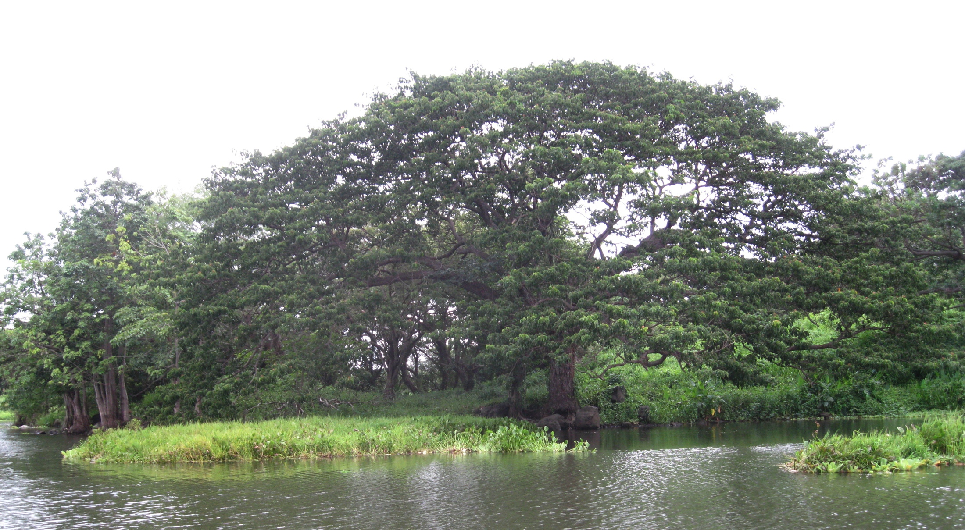
Welcome!!!

Slide 3
Today’s Agenda
9:30 – 9:35 Welcome
9:35– 10:05 Getting What You Want
Tree Designations
Tree Removal and Replacement Program
Public Education
10:05 – 10:25 Issues with the next step – Group Discussion
10:25 – 10:30 Next Step

Slide 4
Tree Designations Example for Document
STREET TREE DESIGNATIONS CRITERIA
In order to designate future replacement trees as they succumb to disease, become hazardous, or die, street tree designation criteria are followed. The Designated Street Tree List appears at the end of this document.

Slide 5
Street Tree Designations Criteria Cont.
All streets in the city are divided into segments based on tree populations, grow space size, and neighborhoods. Blocks with streets which exhibit similar characteristics are grouped into a segment. Some segments span the entire city, while some are only a block long.

Slide 6
Street Tree Designations Criteria Cont.
Each street segment, and its existing trees, take into account quantity, size, health, and aesthetic appropriateness. If the dominant tree on the segment is determined to be the right tree for the right place, it will remain as the designated tree. If not, the following criteria will be considered when selecting a different species.

Slide 7
SPECIES DIVERSITY
The top 15 species should only be designated in existing healthy stands of trees that are considered to be the right trees for the right place. New species, which thrive in similar climates, should be regularly introduced to increase diversity of the urban forest. When filling vacancies to complete existing monocultures, combinations of two tree types with similar characteristics may be used.

Slide 8
AESTHETICS AND NEIGHBORHOOD CHARACTER
If a new species is considered for a street segment, its appearance alongside existing trees must be considered. Since this plan will be implemented over time, new trees will be phased in one at a time, so they must blend aesthetically with existing trees and consider the neighborhood character during the replacement process.

Slide 9
TREE SITE AND GROW SPACE
The grow space available at the tree site is the most significant factor in tree selection. The soil volume is limited in small cut-outs and parkways and the list of trees that will thrive in those conditions is short. Root pruning may be necessary for trees planted in small grow spaces, so a tree planted in such a space must be able to tolerate root pruning.

Slide 10
TREE SITE AND GROW SPACE
Large grow spaces offer an opportunity to increase canopy cover and environmental benefits for the City and a large range of trees can be planted in area with plenty of soil volume.

Slide 11
CANOPY SIZE
The mature size of the canopy is also a factor in tree selection. Adjacent building size and setback should be evaluated to determine whether a tree should have an upright, vase shaped, or spreading canopy.

Slide 12
CANOPY SIZE
Both vertical and horizontal shapes are considered. Increasing the canopy cover over the City is the objective, so the largest possible tree for the grow space should be considered.

Slide 13
LAND USE AND TRAFFIC CONSIDERATIONS
.
Commercial districts with boulevards will be considered differently than residential streets. Tree debris should always be considered on streets, which are used for parking.

Slide 14
LAND USE AND TRAFFIC CONSIDERATIONS
Trees that line streets that have truck traffic need to be tolerant of being limbed up when young. Trees that are tolerant of pollution and help mitigate pollution should be used for high traffic streets and areas in close proximity to the freeway. Shade and comfort of pedestrians will always be considered

Slide 15
MICRO-CLIMATE AND GROWING CONDITIONS
Some trees are adapted to grow in salt air and wind and others need some heat and protection from wind to thrive. Growing conditions for each street will be considered. Because the majority of trees will not be irrigated, the trees need to be able to survive on water when young, tapering off to little water when established.

Slide 16
AVAILABILITY
Research should continually be done for all new species introductions regarding the possibility of having them grown locally. Uncommon species may need to be contract grown to create availability for this species.

Slide 17
Example List
Street Segment # Street Segment From & To Existing Species Recommended Replacement Species Alternate Species Comments
Main Street 1st – 3rd Ficus nitida Jacaranda mimosifolia Tabebuia ipe 4’ cut outs
Main Street 4th – 7th Gingko biloba Same None 6’ parkway
Main Street 8th –10th
Quad East Side Quercus agrifolia Same None Historic
5253 West Side Eucalyptus Platanus acerifolia & Cercis

Slide 18
Long Term Removal and Replacement Program

Slide 19
Definition
It is a program for the removal of undesirable trees and inappropriate trees.
Undesirable trees are trees that possess undesirable characteristics significant enough to have caused their elimination form future plantings i.e. Carob (Ceratonia siliqua).

Slide 20
Definition
Inappropriate trees are desirable trees that are planted in the wrong place i.e. large trees under electric wires or in small planting spaces.

Slide 21
Undesirable Trees
Species (common & botanical name) – Undesirable Characteristics
1. Carob, Ceratonia siliqua – Prone to wood rot, weak structure, seed pod litter
2. Carrotwood, Cupaniopsis anacardiodes – weak structure & seed pod litter
3. Brazilian Pepper, Schinus terebinthifolius – weak structure, seed pod litter

Slide 22
Process
Trees deemed to be undesirable will be placed on the Long Term Removal and Replacement program based on severity of overall deficiencies including width of parkway, species, condition of trees, or extent and number of recurrences of chronic structural damage to improvements.
Trees will be evaluated on the above basis and given a rating of between one and five, with five being the most severe.

Slide 23
Process Cont.
Removal and replacements will be scheduled based on ratings. No more than 15% of the identified trees can be removed within a three year period. So as not to have a negative impact.
Trees will be evaluated and reprioritized every five years.
Removal and Replacement is contingent on funding.

Slide 24
Tree Evaluation Form
Date _________ Species _____________ Designated Species________
Location________________________________
Tree Rating Criteria Possible Points Points Received Comments
Private/public hardscape damage 20
Does the distance ______ft. to the
water/sewer line cause a problem 10
Is the tree location a problem
(electric lines, parkway width,
proximity to St. lights, intersections etc.) 20
What is the tree’s general health 25
Are there extenuating circumstances as
It relates to the above problems 25
Total Points ________ Rating __________
(ratings: 1-20 = 1; 20-40 =2; 40 – 60 = 3; 60 – 80 = 4; 80 – 100 = 5)

Slide 25
Work Plan
Location - Species - Rating - Schedule - Alternate Schedule - Replacement Species - Comments
3429 Hale St - Shamel Ash – 5 – 2013 - 2015 London Plane - Poor Structure & Hardscape Damage
3433 Hale St - Shamel Ash – 3 - 2020 – 2018 - London Plane - Minor Damage
3435 Hale St - Shamel Ash – 4 – 2015 – 2014 - London Plane - Poor Structure Minor Damage
3437 Hale St - Shamel Ash – 2 – 2025 – 2030 - London Plane - Good Condition Slight Sidewalk Damage

Slide 26
Public Education

Slide 27
Public Education
To ensure that residents, business owners and merchants are aware of the benefits trees offer the community and that residents, property owners, architects, engineers, planners, developers, and landscape and tree contractors are familiar with Best Management Practices in this plan for the planting and care of trees. To also ensure that residents are included as stakeholders in decision making.

Slide 28
Public Education Cont.
Conduct periodic public workshops on tree care.
Provide residents, students etc. with information that is specific to the trees adjacent to their homes, classes, project etc. and their care.

Slide 29
Public Education Cont.
Produce a public information packet on Best Management Practices on tree care and regulations governing street, park, school, HOA, etc trees.

Slide 30
Public Education Cont.
Include information regarding Best Management Practices for the urban forest in the Homeowners Guide to Building Permits and other publications related to development.

Slide 31
Public Education Cont.
Develop tree care programming for Local TV and other current media outlets.
Strategically utilize social media in disseminating information about the urban forest and its care.
Periodically mount displays of tree care books and other publications at the library, club house, offices, etc.

Slide 32
Public Education Cont.
Make the tree inventory available online.
Provide links to photographs and information about each tree species.
Initiate a periodic column in local paper, school paper, HOA newsletter etc. and focused on the urban forest and topics relating to tree care and benefits from trees.
Highlight remarkable trees such as designated landmark trees, include photographs of trees exhibiting seasonal behavior and invite tree photographs from the community.

Slide 33
Public Education Cont.
Biennially evaluate outreach method efficacy and adjust methods as necessary.
Create educational programs about the urban forest for youth.

Slide 34
OUTREACH TO RESIDENTS AND BUSINESSES
The City will make a targeted effort to educate residents, landscape contractors, tree care contractors, landscape architects, architects, developers, and real estate agents who work in the City (or School, HOA, Apt Complex, etc) on the City’s urban forest policies, and the penalties for not adhering to them. The public education program will clarify the responsibilities of the City and adjacent residents and merchants on the care of newly planted street trees.

Slide 35
COMMUNITY TREE PLANTING
Celebrate Arbor Day each year and provide the opportunity for community participation in tree plantings. Involvement in such activities will cause members of the community to gain an appreciation for the urban forest of tomorrow and take an active role in creating the forest’s green legacy.

Slide 36
Current Concerns & Issues Discussion

Slide 37
What is Next & Assignments

