Slide 1
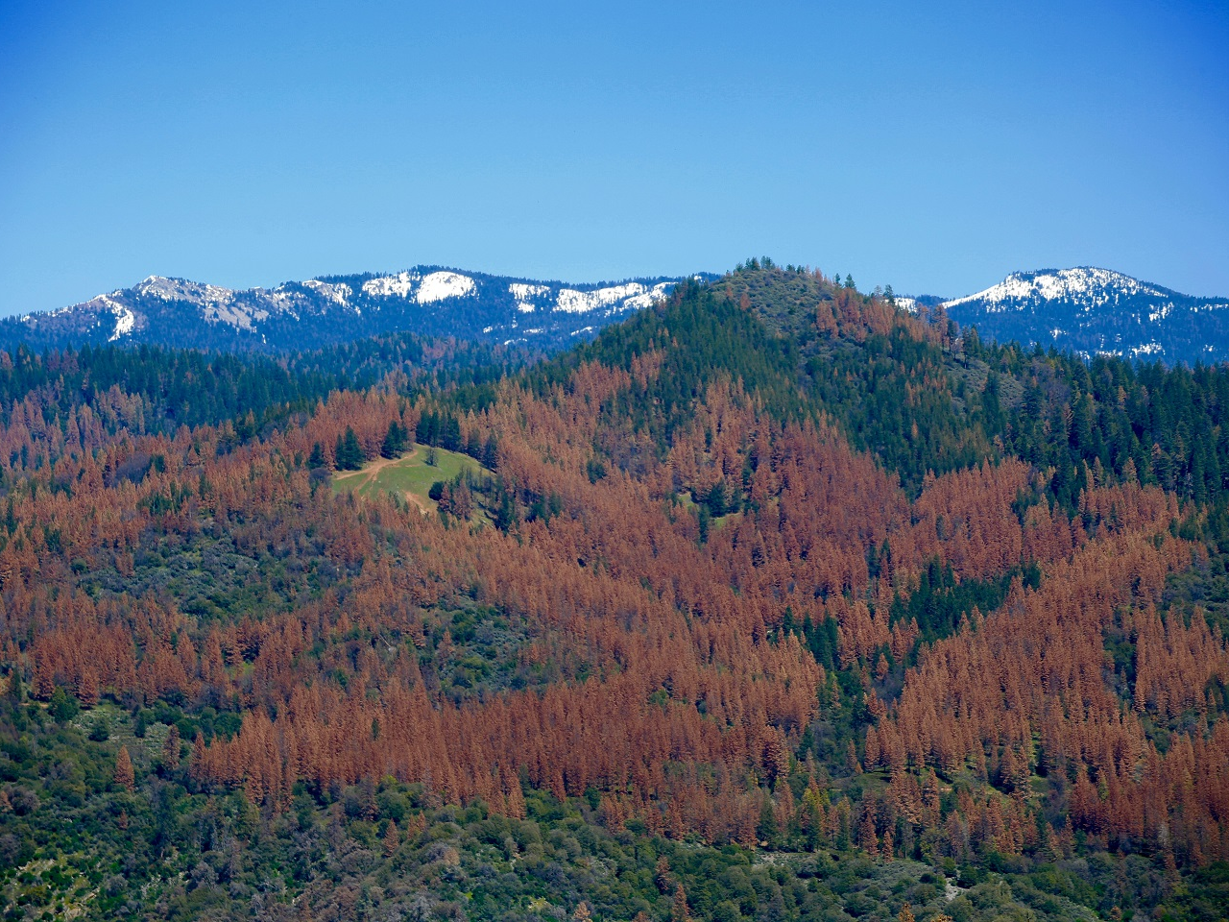
The California Drought and Climate Change
Mark Jackson Meteorologist in Charge NOAA/National Weather Service
Los Angeles/Oxnard, CA
Background photo: Steve Dunsky/USFS

Slide 2
El Niño 2015-16 Was a Missed Opportunity for Southern California
Oct
Nov
Dec
Jan
Feb
Mar
Strong El Niño
Apr
May
30 yr ave

Slide 3
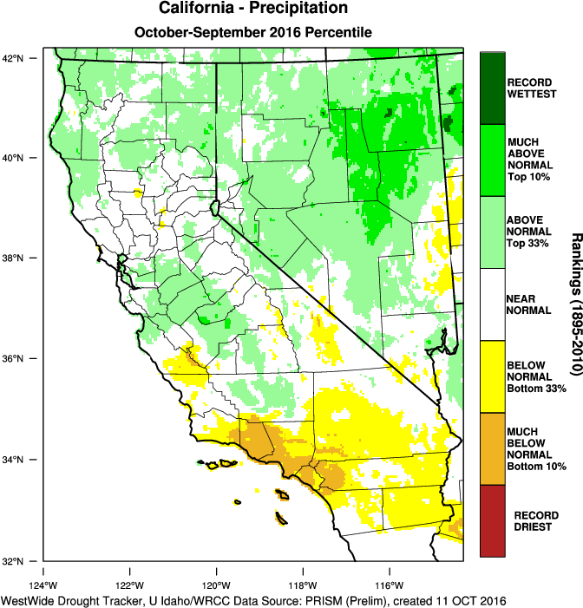
Precipitation Average Ranking Last 12 Months

Slide 4
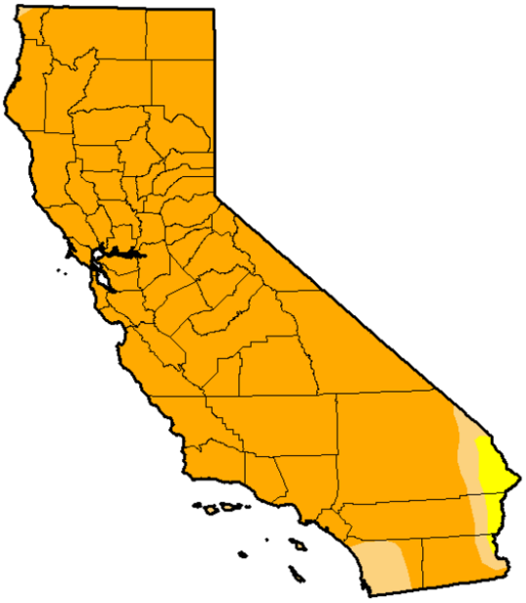
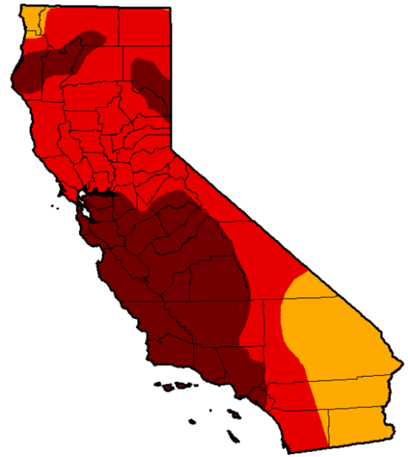
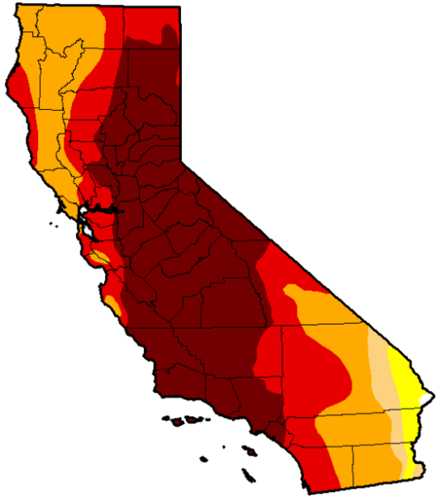
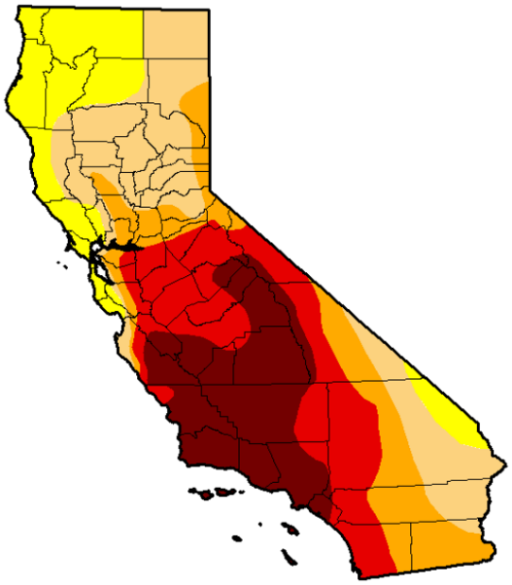
As of July 2016, nearly 43% of California was in Extreme to Exceptional Drought
Jan 2014 was the first time the Exceptional Drought category appeared in California since the product was first produced in
January of 2000
July
2013
July
2014
July
2015
July
2016
Abnormally Dry
Moderate Drought
Severe Drought
Extreme Drought
Exceptional Drought

Slide 5
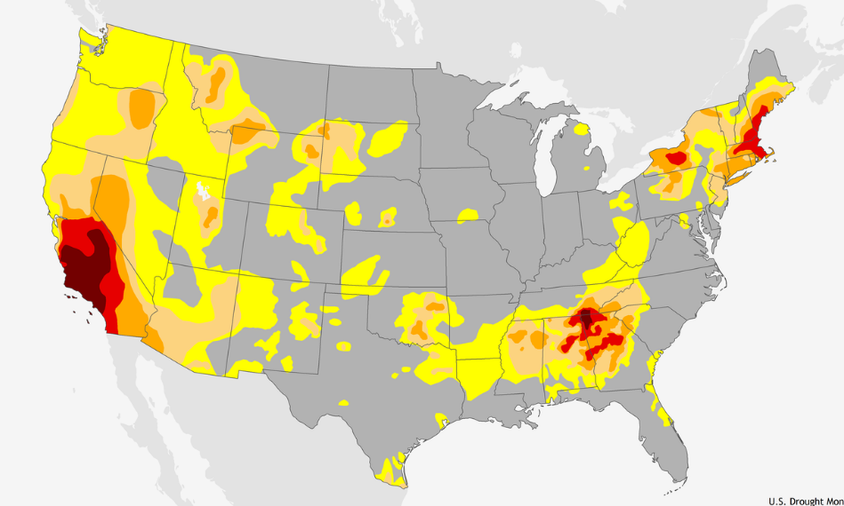
Latest Drought Monitor droughtmonitor.unl.edu
U.S. Drought Monitor October 4, 2016

Slide 6
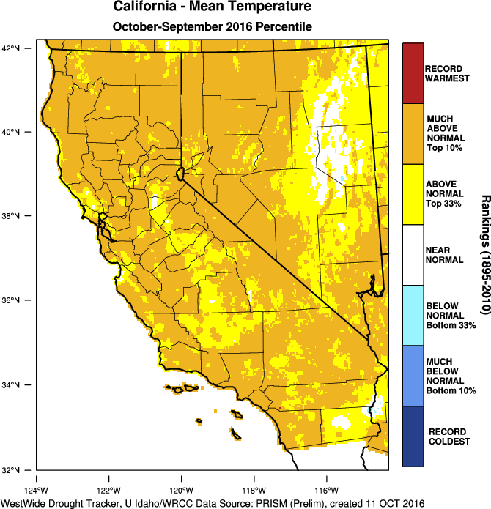
Temperature Average Ranking Last 11 Months

Slide 7
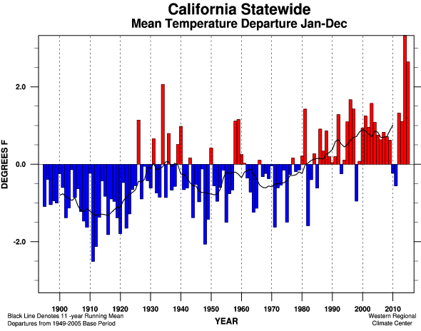
Linear Trend 1895-2015 +1.71 ± 0.42ºF/100 yr
Linear Trend 1949-2015 +3.00 ± 1.02ºF/100 yr
Linear Trend 1975-2015 +4.38 ± 2.20ºF/100 yr
Warmest Year 59.4ºF in 2014
Jan-Dec 2015 58.7ºF Rank 120 of 121
Compared to 1949-2005 base period
January 2011 – Dec 2015 was the warmest 5-year
period on record in California

Slide 8
Palmer Drought Severity Index A Supply-and-Demand Model of Soil Moisture
Area = California Time period starts June 1900 and ends June 2016
Notes:
The Palmer drought index is based on a supply-and-demand model of soil moisture. Supply is comparatively straightforward to calculate, but demand is more complicated, as it depends on many factors: not just temperature and the amount of moisture in the soil but also hard-to-calibrate factors including evapotranspiration and recharge rates. Palmer tried to overcome such difficulties by developing an algorithm that approximated them based on the most readily available data, precipitation and temperature.

Slide 9
The Outlook For The Winter of 2016-17

Slide 10
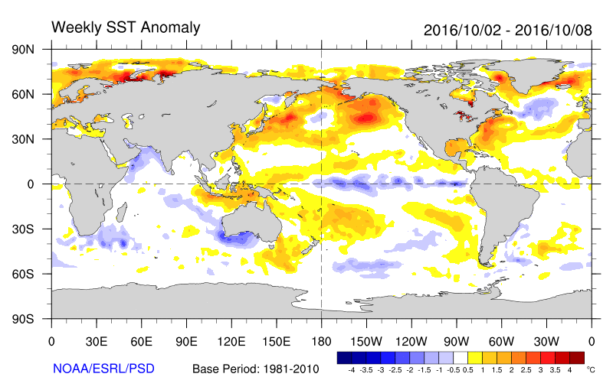
The Latest on ENSO and What it Might Mean for California
Conditions neutral
Weekly Niño 3.4 sea surface temperature anomaly now at -0.9ºC (black box at right)
La Niña conditions favored to develop
Officially ~70% chance
La Niña Watch issued by NOAA’s Climate Prediction Center

Slide 11
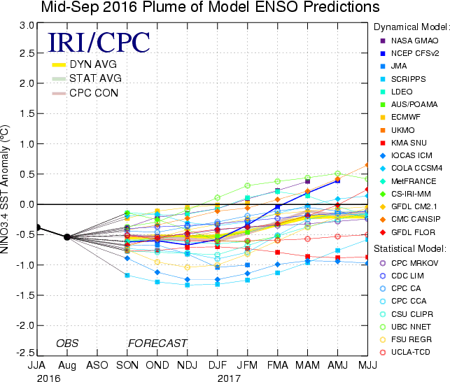
Weak
Moderate
Strong

Slide 13
Notes:
The Climate Prediction Center is forecasting a Weak La Niña, but what does that mean for us? Annual precipitation totals vary by location, but on a Statewide look, 70% of Weak La Niña years have had below normal precipitation. Looking locally, 70% of Weak La Niña’s gave below normal precipitation for Stockton and 60% were below normal for the Central Sierra.
Twitter:
Weak #LaNiña forecast. 70% of these resulted in below normal precipitation for San Joaquin County #cawx #CADrought

Slide 15
Looking Well Beyond This Winter

Slide 16
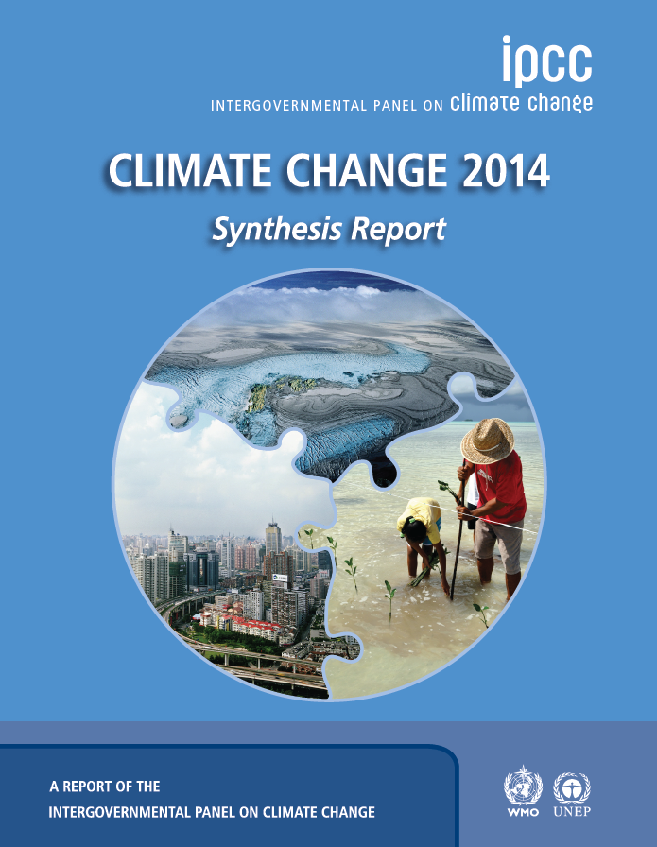
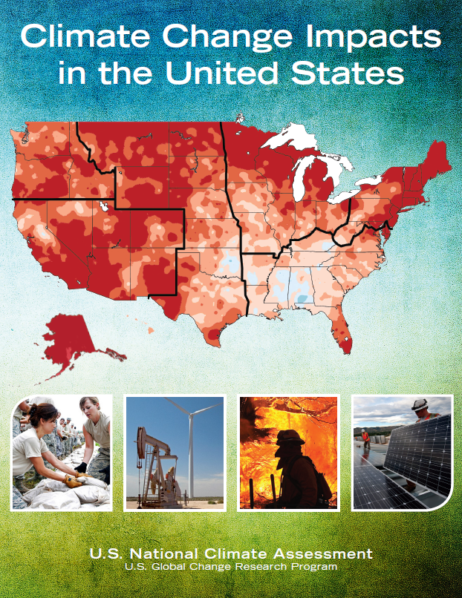
https://www.ipcc.ch/report/ar5/
http://nca2014.globalchange.gov/report
Notes:
First IPCC report 1990. This is the 5th Assessment. The 6th Assessment is targeted for 2022. The 5th Assessment had 259 scientific authors from 39 countries,
Melillo, Jerry M., Terese (T.C.) Richmond, and Gary W. Yohe, Eds., 2014: Climate Change Impacts in the United States: The Third National Climate Assessment. U.S. Global Change Research Program, 841 pp. doi:10.7930/J0Z31WJ2.
National Climate Assessment: A team of more than 300 experts (see page 98), guided by a 60-member National Climate Assessment and Development Advisory Committee (listed on page vi) produced the full report – the largest and most diverse team to produce a U.S. climate assessment.
“This report is the result of a three-year analytical effort by a team of over 300 experts, overseen by a broadly constituted Federal Advisory Committee of 60 members. It was developed from information and analyses gathered in over 70 workshops and listening sessions held across the country. It was subjected to extensive review by the public and by scientific experts in and out of government, including a special panel of the National Research Council of the National Academy of Sciences. This process of unprecedented rigor and transparency was undertaken so that the findings of the National Climate Assessment would rest on the firmest possible base of expert judgment. “

Slide 17
Latest Assessment on Climate Change 2014 IPCC 5th Assessment (AR5)
Warming of the climate system is unequivocal
Anthropogenic greenhouse gas emissions are now higher than ever
Ocean warming dominates the increase in energy stored in the climate system
Human influence on the climate system is clear
Many aspects of climate change and their impacts will continue for centuries, even if anthropogenic emissions of greenhouse gases are stopped
Adaptation and mitigation are complementary strategies for reducing and managing the risks of climate change

Slide 18
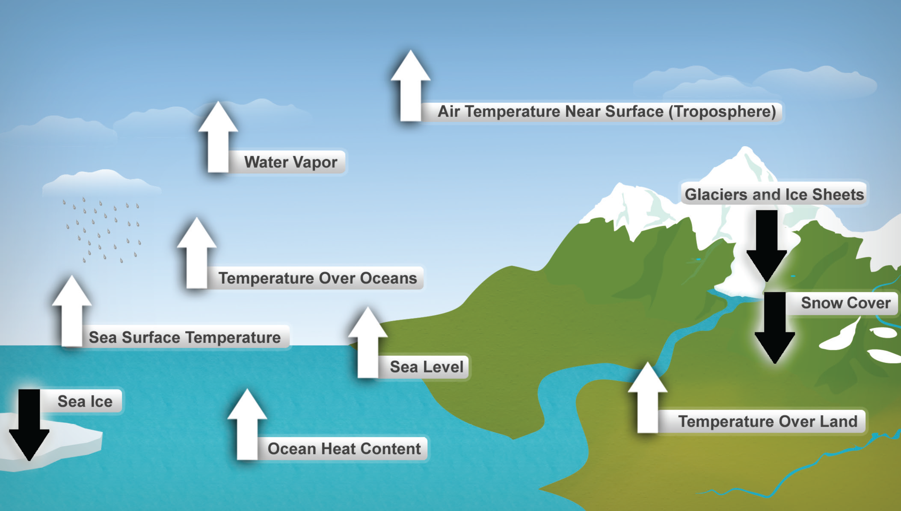
Ten Indicators of a Warming World

Slide 19
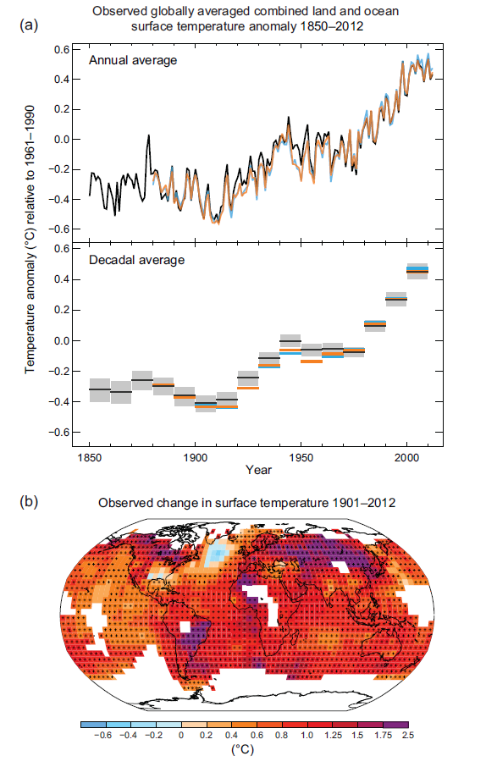
Examining Observed Changes in Land and Ocean Surface Temperatures Between 1850 and 2012
Each of the last three decades has been successively warmer at the Earth’s surface than any preceding decade since 1850 (IPCC 2014)
Comparing Change in Surface Temperature From 1901 to 2012

Slide 20
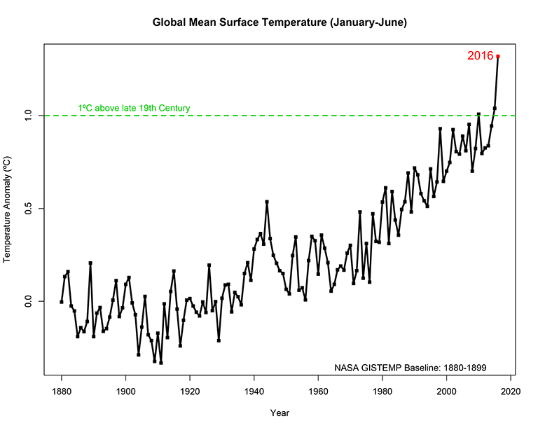
January-June 2016 global temperatures were 1.89ºF above the 20th century average. This was the planet’s warmest half-year on record, breaking the previous record set in 2015 of 0.36ºF.

Slide 21
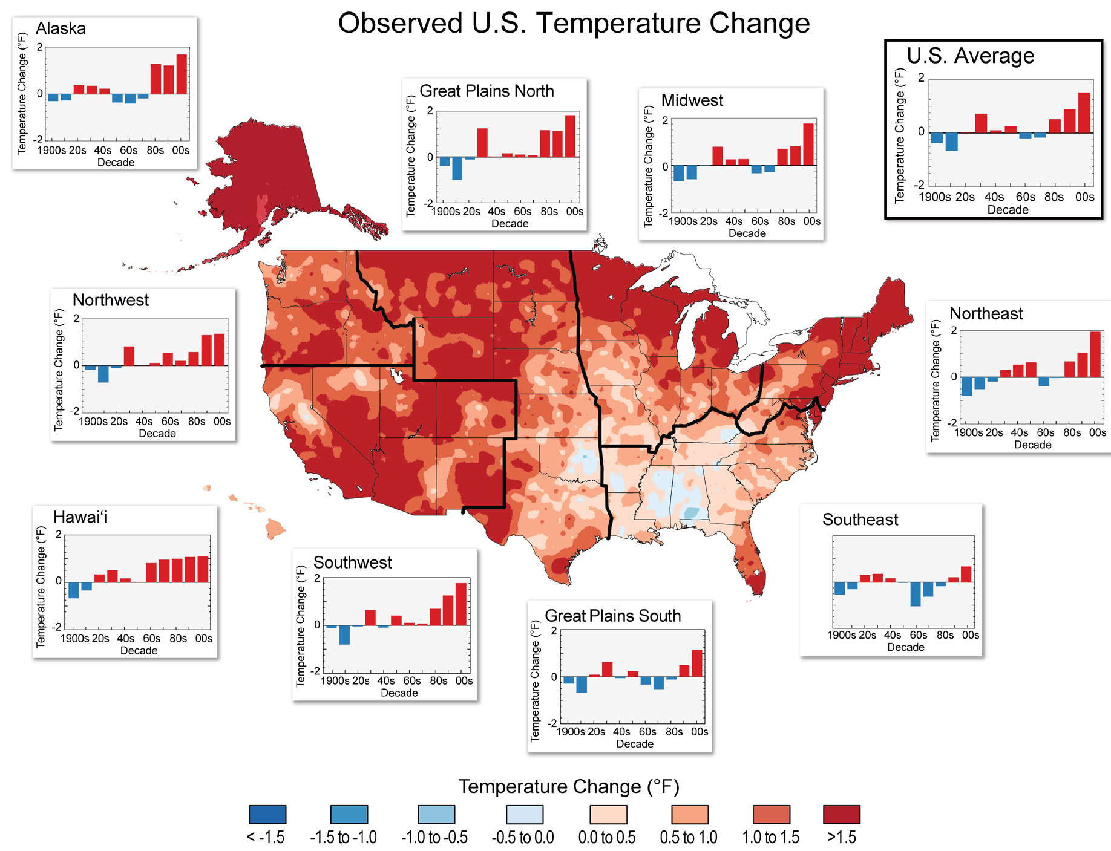
1991-2012 versus 1901-1960 average
U.S. Nat’l Climate Assessment

Slide 22
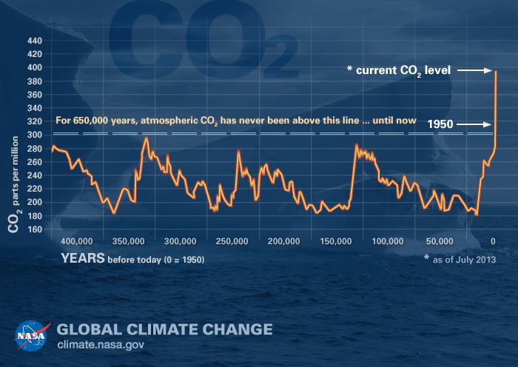
Human influence on the climate system is clear (evidence has grown since AR4)

Slide 23
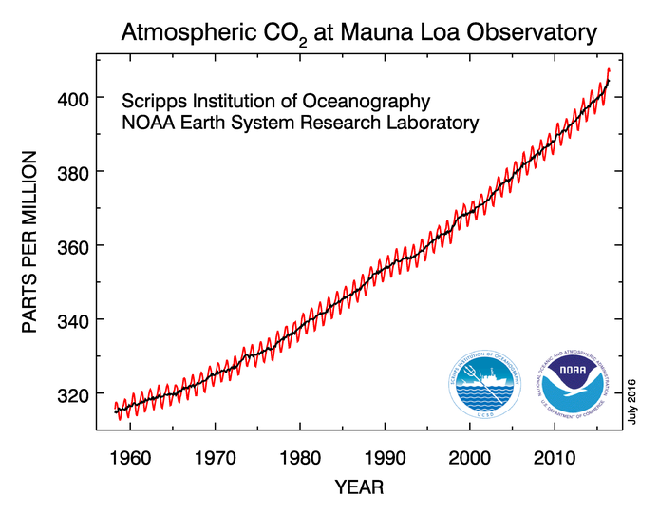
“Carbon dioxide levels are increasing faster than they have in hundreds of thousands of years. It's explosive compared to natural processes.“
Peter Trans Lead Scientist for NOAA’s Global Greenhouse Gas Reference Network
Notes:
The atmospheric concentrations of carbon dioxide, methane, and nitrous oxide have increased to levels unprecedented in at least the last 800,000 years. IPCC WG1 AR5
The growth rate of atmospheric carbon dioxide measured at NOAA’s Mauna Loa Observatory in Hawai’i jumped by 3.05 parts per million during 2015, the largest year-to-year increase in 56 years of research.
Upon reaching the 400 ppm milestone, Dr. Erika Podest, a carbon and water researcher with NASA, said:
“Carbon dioxide concentrations haven’t been this high in millions of years. Even more alarming is the rate of increase in the last five decades and the fact that carbon dioxide stays in the atmosphere for hundreds or thousands of years. This milestone is a wake up call that our actions in response to climate change need to match the persistent rise in carbon dioxide. Climate change is a threat to life on Earth and we can no longer afford to be spectators.”
Cumulative emissions of CO₂ largely determine global mean surface warming by the late 21st century and beyond (see Figure SPM.10). Most aspects of climate change will persist for many centuries even if emissions of CO₂ are stopped. This represents a substantial multi-century climate change commitment created by past, present and future emissions of CO₂. IPCC WG1 AR5

Slide 24
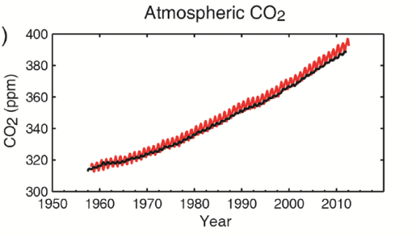
IPCC AR5 Simulation CO₂ Values
4 new scenarios, or Representative Concentration Pathways (RCPs), are identified by their approximate total radiative forcing in year 2100 relative to 1750:
2.6 W/m² for RCP2.6
mitigation scenario (assumes more than 70% cuts by 2050 and further cuts by 2100
421 ppm CO₂)
4.5 W/m² for RCP4.5
stabilization scenario
538 ppm CO₂
6.0 W/m² for RCP6.0
stabilization scenario
670 ppm CO₂
8.5 W/m² for RCP8.5
very high emissions
936 ppm CO₂
Notes:
So I just showed you the chart of CO2 PPm and that is in the lower left portion of this chart. Added to it are four lines representing the changes in Co2 ppm in the four scenarios used throughout the AR5 study and sometimes referenced in the NCA3.
You can see that to get these charts to scale I had to make the forecast area much larger and that the slope of the line from 1950-today is about equal to the two “stabilization scenarios”.
Just like stocks, past performance does not necessarily indicate future earnings – and if you recall the image of the world’s population within a circle of the “developing” economy – it would seem to be that left unchecked the very high emission scenario is not unreasonable.

Slide 25
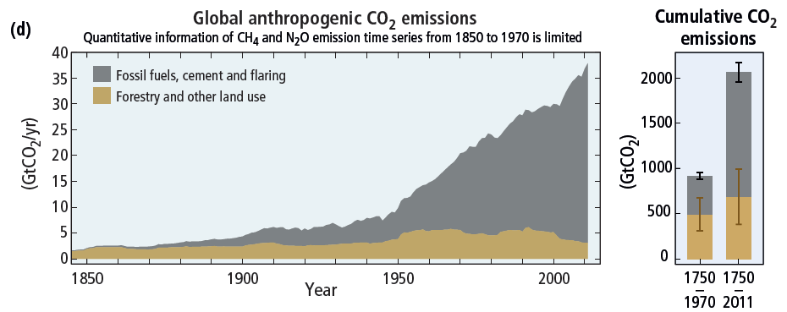
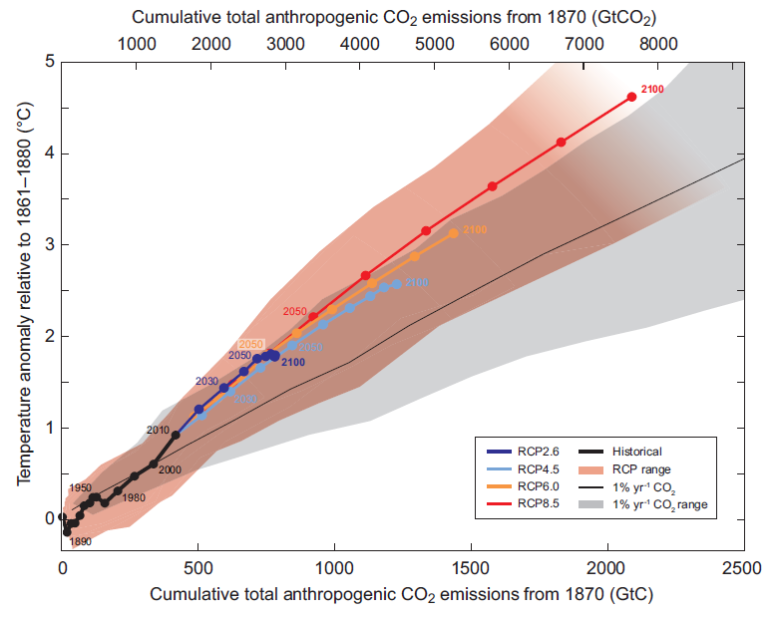
Many aspects of climate change and associated impacts will continue for centuries, even if anthropogenic emissions of greenhouse gases are stopped. The risks of abrupt or irreversible changes increase as the magnitude of the warming increases (IPCC 2014).
RCP2.6 = 475 ppm RCP4.5 = 630 ppm
RCP6.0 = 800 ppm
RCP8.5 = 1313 ppm
Notes:
Anthropogenic greenhouse gas emissions have increased since the pre-industrial era driven largely by economic and population growth. From 2000 to 2010 emissions were the highest in history. Historical emissions have driven atmospheric concentrations of carbon dioxide, methane and nitrous oxide to levels that are unprecedented in at least the last 800,000 years, leading to an uptake of energy by the climate system.

Slide 26
Some Projected Specific Impacts

Slide 27
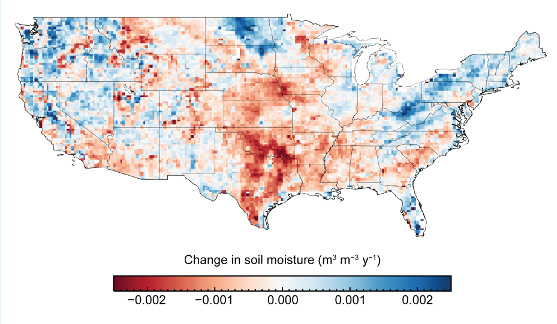
Droughts Highly Confident – But Uncertainties in Regional Projections and Uncertainties in Recent Trends
Changes in annual surface soil moisture per year over the period 1988 to 2010
Drier
Wetter
U.S. Nat’l Climate Assessment
Notes:
Many climate variables affect agriculture. The maps above show projected changes in key climate variables affecting agricultural productivity for the end of the century (2070-2099) compared to 1971-2000.

Slide 28
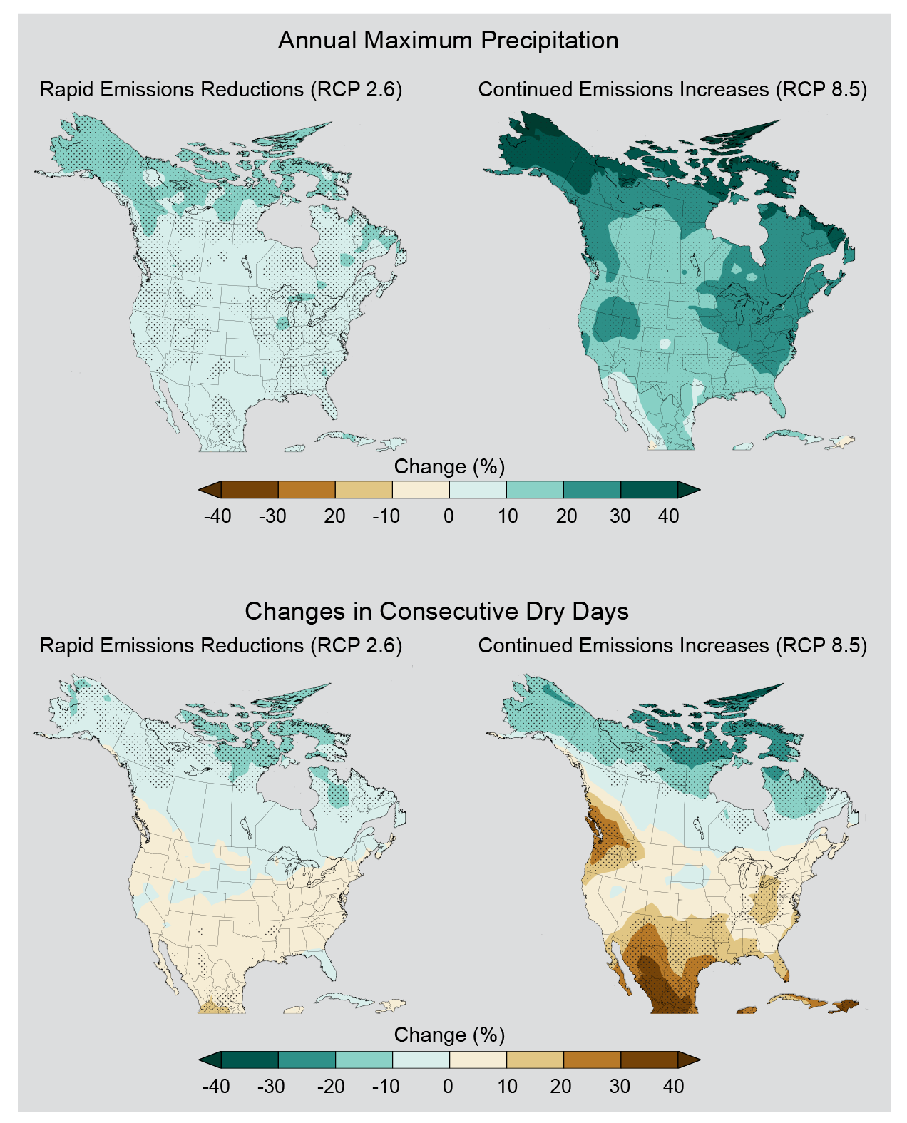
Simulated changes in the average amount of precipitation falling on the wettest day of the year for the period 2070-2099 as compared to 1971-2000
drier
wetter
Simulated changes in the annual maximum number of consecutive dry days (days receiving less than 0.04 inches (1 mm) of precipitation) for the period 2070-2099 as compared to 1971-2000
Less
More
U.S. Climate Change Assessment

Slide 29
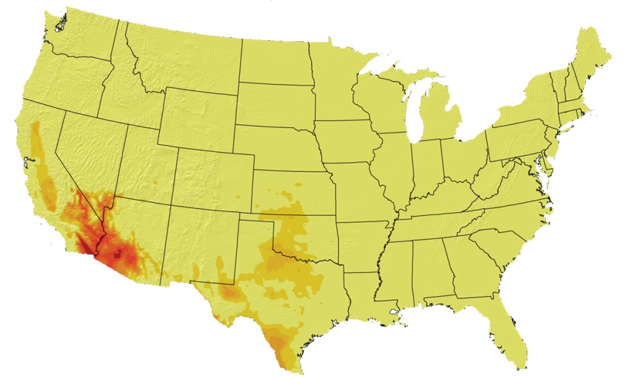
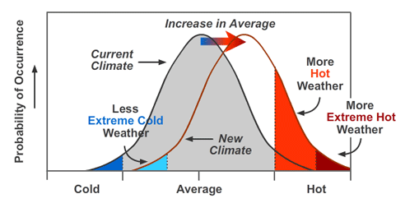
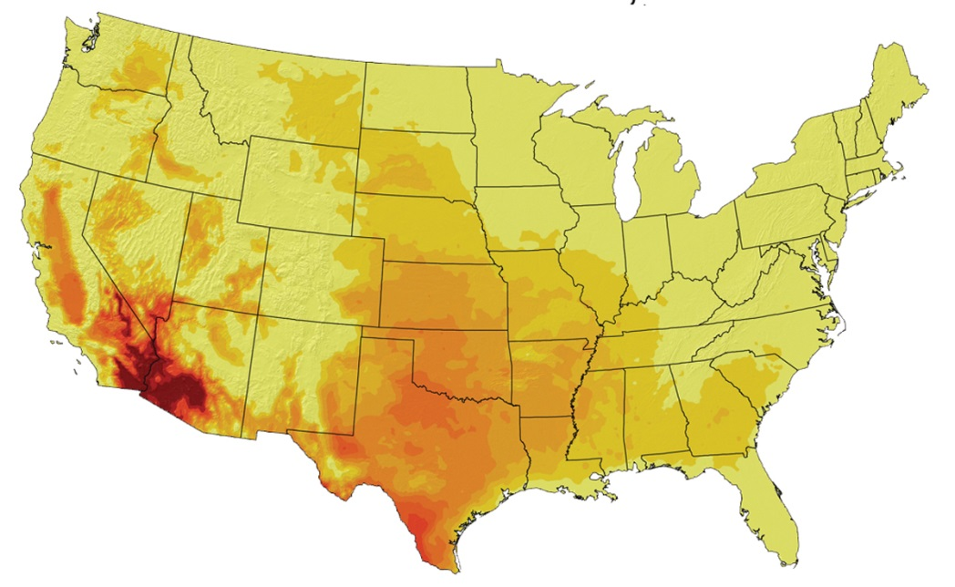
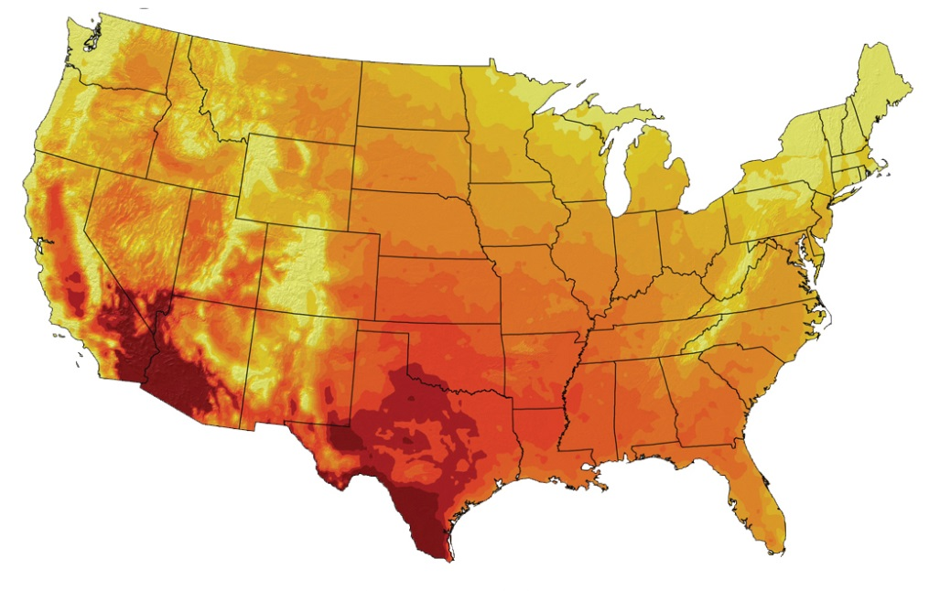
Heat Waves Highly Confident
Recent 1961-1979
Number of days over 100 deg F
<10 20 30 45 60 75 90 105 >120
RCP2.6, 2080-2099
RCP8.5, 2080-2099
Image Source: U.S. Global Change Research Program

Slide 30
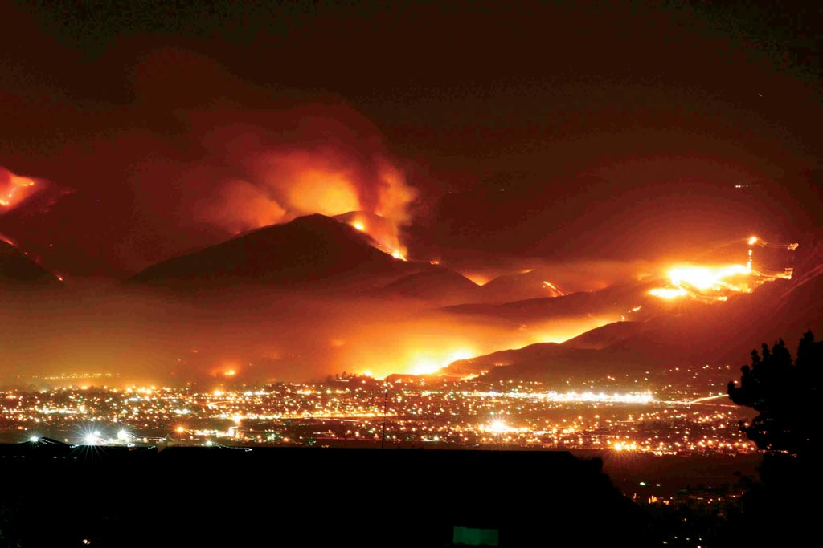
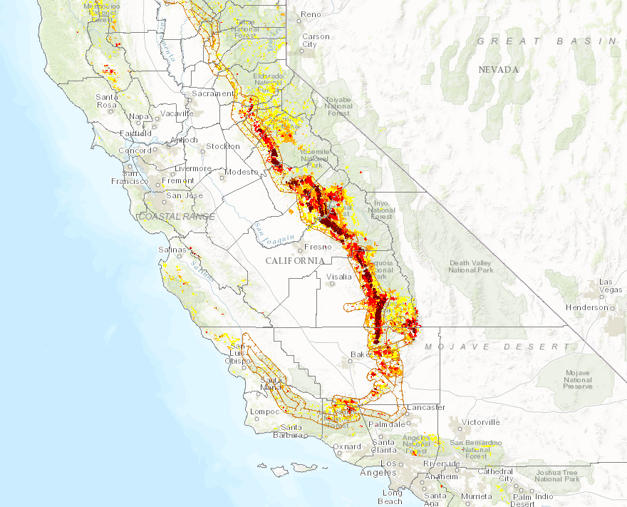
Wildfires Highly Confident
Increased warming, drought, and insect outbreaks, all caused by or linked to climate change, have increased wildfires and impacts to people and ecosystems in the Southwest. Fire models project more wildfire and increased risks to communities across extensive areas (NCA)
Tree Mortality – September ‘16 (Dead Trees Per Acre)
>0 – 5 (Background Mortality)
5-15
15-40
40+

Slide 31
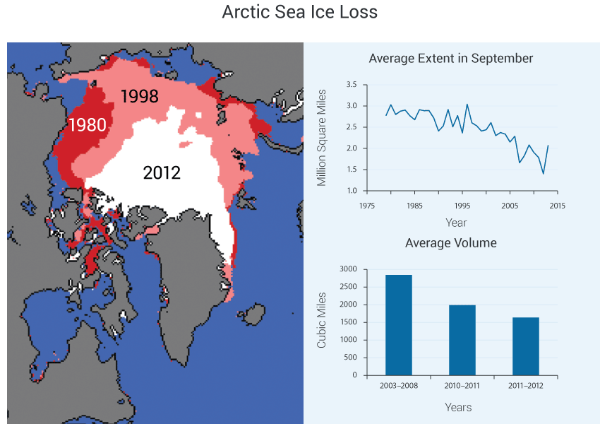
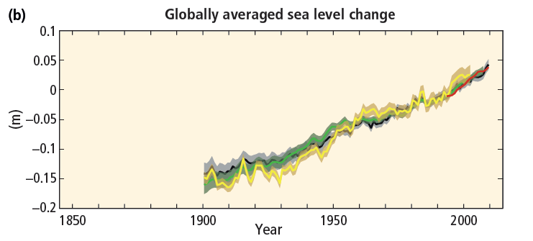
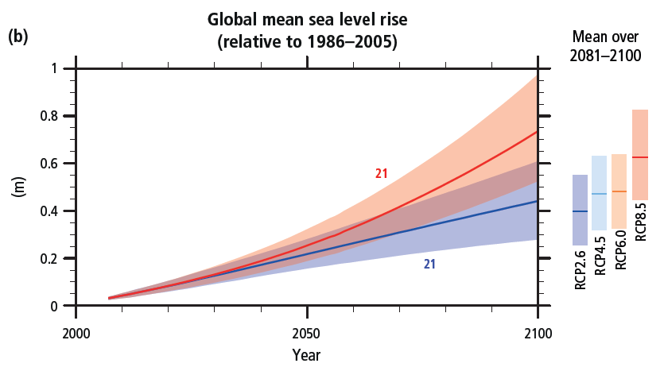
The rate of sea level rise since the mid-19th century has been larger than the mean rate during the previous two millennia (IPCC AR5)
Change is relative to 1993, with colors indicating different datasets
Sea level rise is
from the ocean’s
thermal expansion plus the amount of
melting in Greenland
and the Antarctic

Slide 32
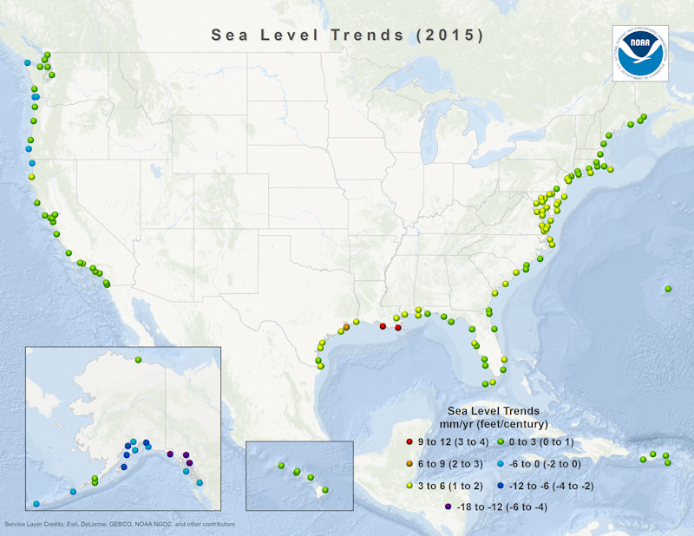
(Based on minimum 30 years of data)
http://www.tidesandcurrents.noaa.gov/sltrends/slrmap.htm

Slide 33
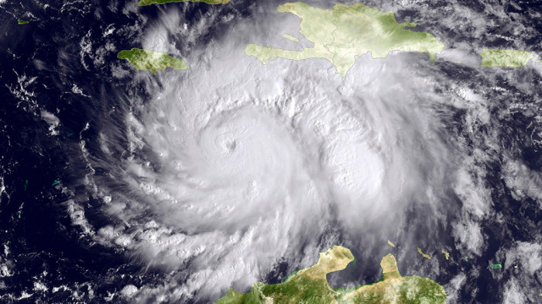
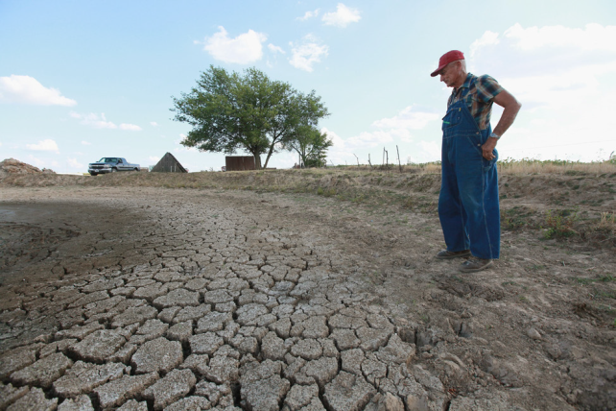
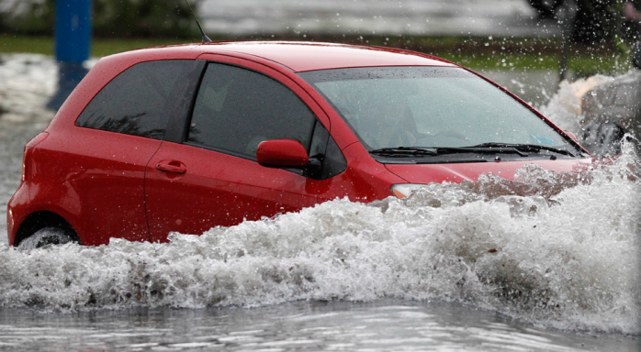
Summarizing Climate Change and Extreme Weather Event in the U.S.
Heat waves have become more frequent and intense, especially in the West, with trend projected to continue.
The intensity, frequency, and duration of North Atlantic hurricanes have increased. Hurricane-associated storm intensity and rainfall rates are projected to increase as the climate continues to warm.
Difficult to associate one extreme event to climate change, rather trends indicate a higher frequency of events
There have been regional trends in floods and droughts. Droughts in the Southwest are projected to become more intense. Increases in the frequency and intensity of extreme precipitation events are projected for all U.S. regions.

Slide 34
The Big Picture
IPCC 2014

Slide 35
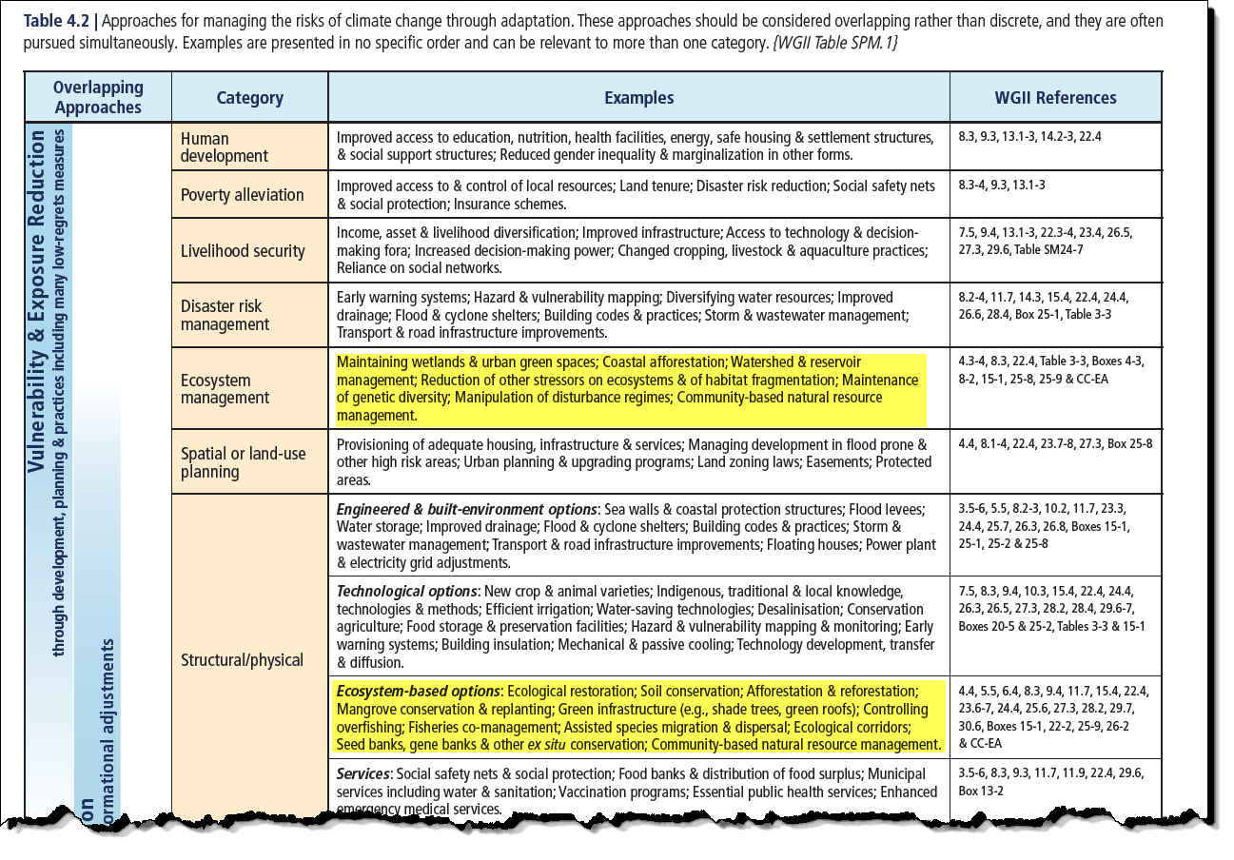
Some Recommended Adaptations From IPCC AR5

Slide 36
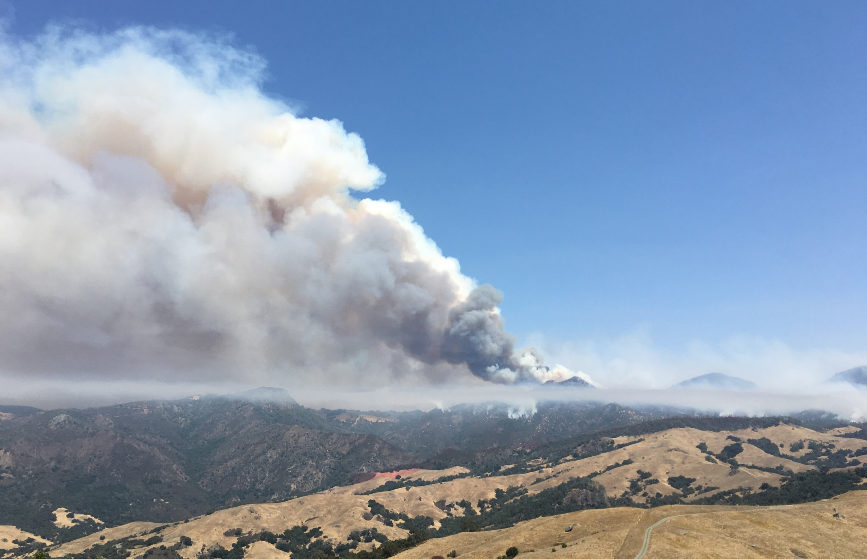
Thank YOU
@NWSLosAngeles
weather.gov/losangeles
NWSLosAngeles
Mark Jackson Meteorologist in Charge
NOAA/National Weather Service
Los Angeles/Oxnard, CA Mark.Jackson@noaa.gov
Chimney Fire, San Luis Obispo County/NWS Photo

